Slide 1
De-mystifying TFS Reporting
Benjamin Day
Level: Intermediate

Slide 2
About the speaker
Owner, Benjamin Day Consulting, Inc.
Email: benday@benday.com
Web: http://www.benday.com
Blog: http://blog.benday.com
Trainer
Visual Studio Team System, Team Foundation Server
Microsoft MVP for C#
Microsoft VSTS/TFS Customer Advisory Council
Leader of Beantown.NET INETA User Group

Slide 3
Agenda
Overview
Tour of the MSF For Agile reports
Tour of the data warehouse
Custom reports with SQL Report Builder
Adhoc reports with Excel
Customize the standard reports

Slide 4
Overview

Slide 5
The Pieces
Team Foundation Server
Web services, .NET Assemblies
SQL Server 2005
11 databases
Visual Studio Team Foundation Server Task Scheduler
Populates the data warehouse
SQL Server Analysis Services
Data warehouse = “TfsWarehouse”
SQL Server Reporting Services
*.rdl files, data sources

Slide 6
Why TFS? Why Reporting?
Failed/troubled projects = lost/wasted $$
TFS helps you to manage complexity & engineer for quality
Gathers a lot of data for you
Work Items, Builds, Unit Tests, Code Coverage, Bugs, Source Control, Project Schedule
Reports help you to understand the data
View the status of your project
Determine when you have quality problems
Determine when you have velocity problems

Slide 7
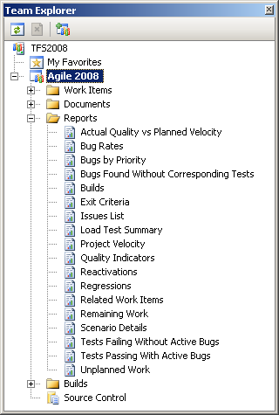
How do you run the reports?
Team Explorer

Slide 8
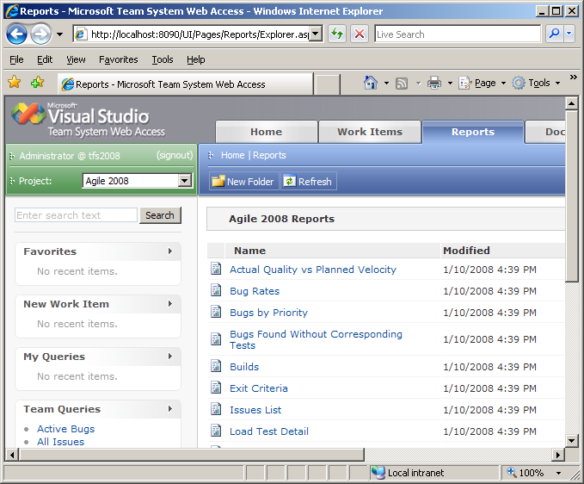
How do you run the reports?
Team System Web Access
http://tfsname:8090

Slide 9
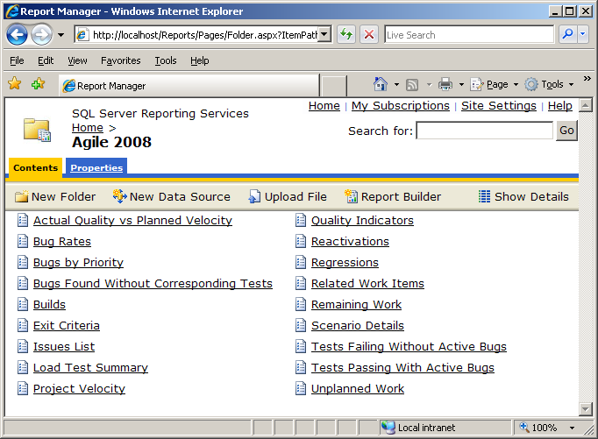
How do you run the reports?
SQL Server Reporting Services Site
http://tfsname/Reports

Slide 10
The Reports

Slide 11
Types of Reports
16 Reports
Project Scheduling
Related Work Items, Remaining Work, Scenario Details, Unplanned Work, Project Velocity
Defects
Bug Rates, Bugs by Priority, Bugs Found Without Corresponding Tests, Reactivations, Regressions
Code
Tests Failing Without Active Bugs, Tests Passing With Active Bugs, Quality Indicators, Builds, Actual Quality vs Planned Velocity

Slide 12
Reports in Agile
Actual Quality vs Planned Velocity
Bug Rates
Bugs by Priority
Bugs Found Without Corresponding Tests
Builds
Load Test Summary
Project Velocity
Quality Indicators
Reactivations
Regressions
Related Work Items
Remaining Work
Scenario Details
Tests Failing Without Active Bugs
Tests Passing With Active Bugs
Unplanned Work

Slide 13
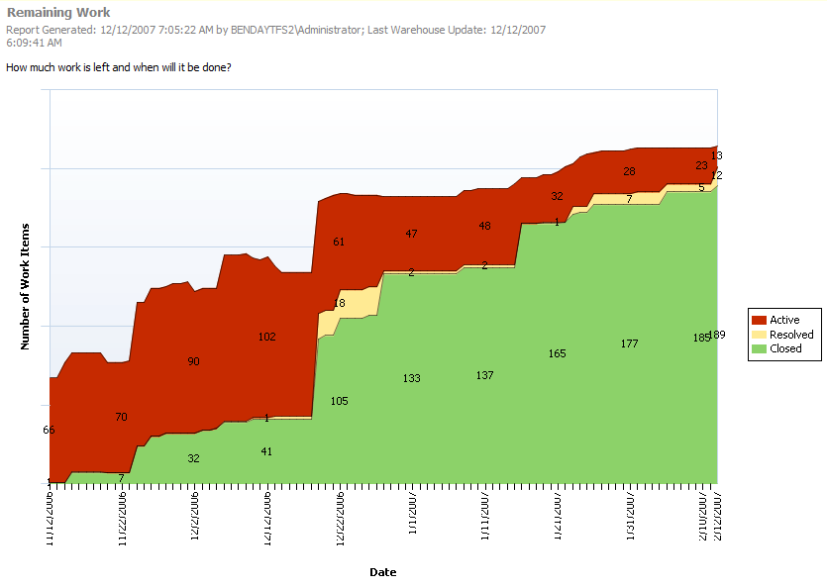
Report: Remaining Work
Tasks per status per date

Slide 14
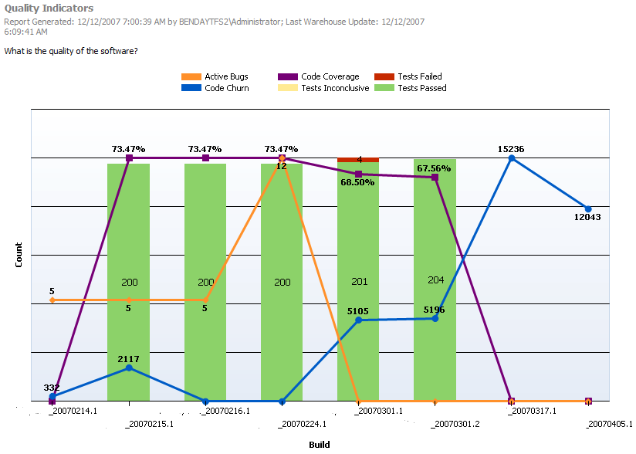
Report: Quality Indicators

Slide 15
Quality Indicators
Am I close to shipping on time?

Slide 16
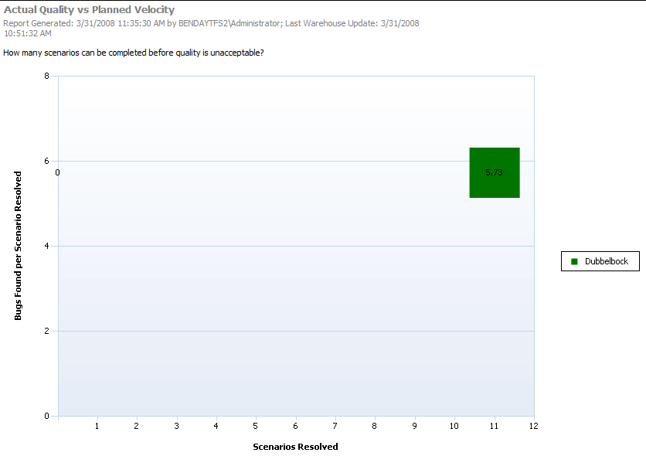
Actual Quality vs Planned Velocity

Slide 17
Report: Actual Quality vs Planned Velocity
Used to optimize quality against development speed
How many bugs per “completed” scenario?
Helps decide whether to focus on new features vs fix bugs

Slide 18
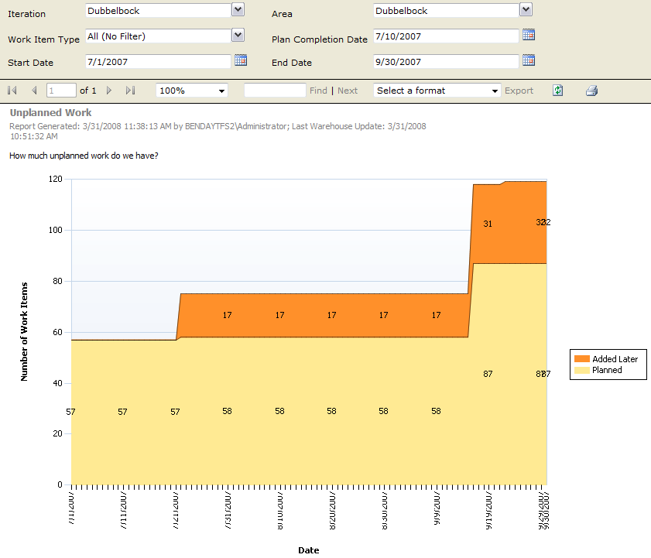
Unplanned Work

Slide 19
Report: Unplanned Work
Progress report
# of work items added after “Plan Completion Date”
Can be filtered by
Area
Iteration
Work Item Type
Date Range
By default, “Plan Completion Date” is incorrect

Slide 20
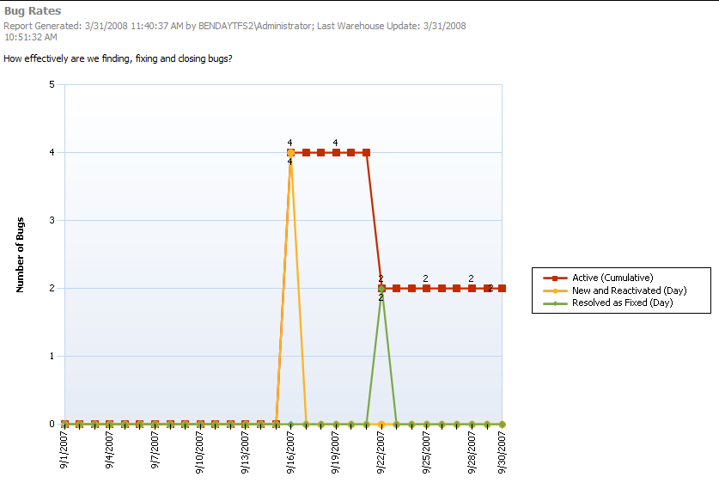
Bug Rates

Slide 21
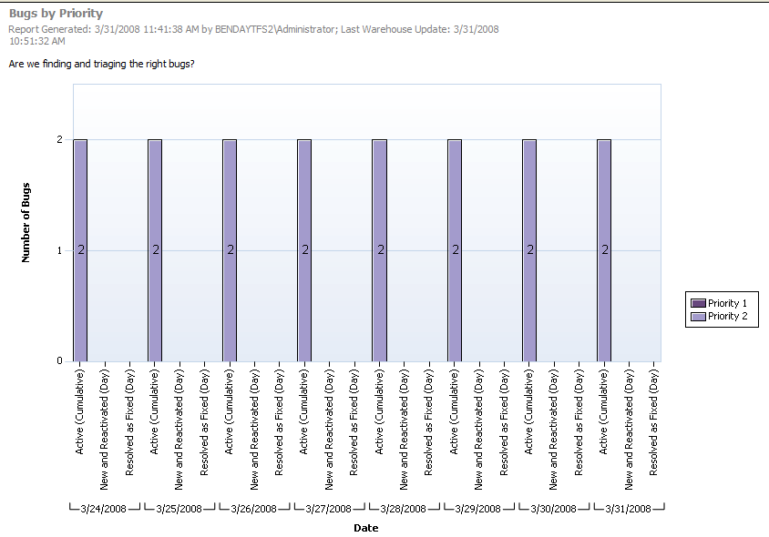
Bugs By Priority

Slide 22
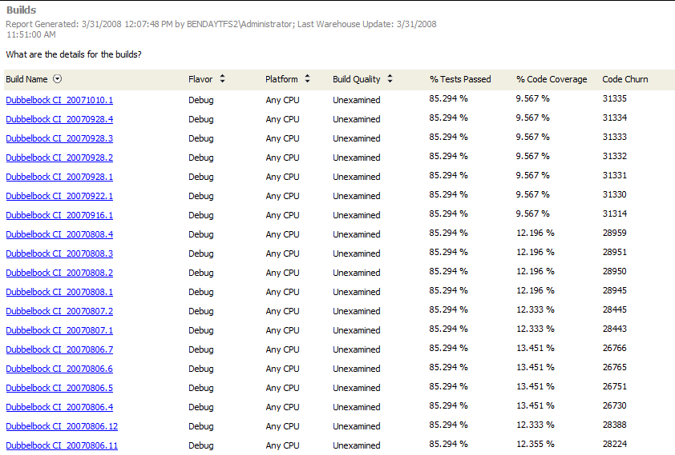
Builds

Slide 23
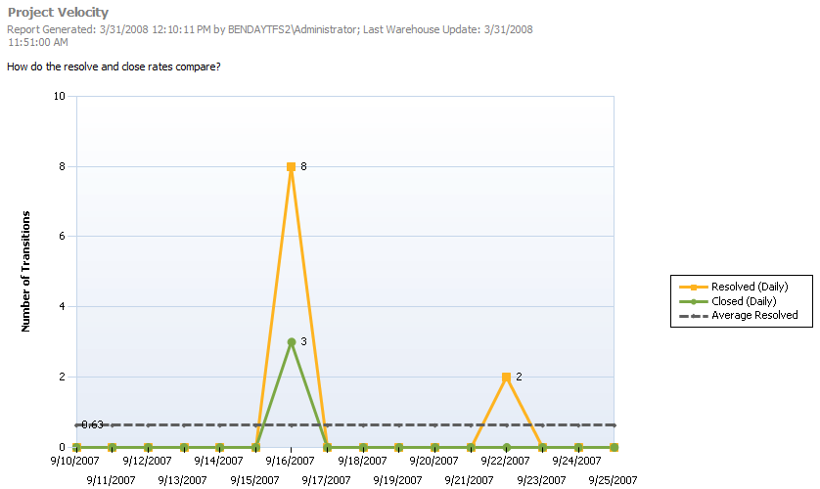
Project Velocity

Slide 24
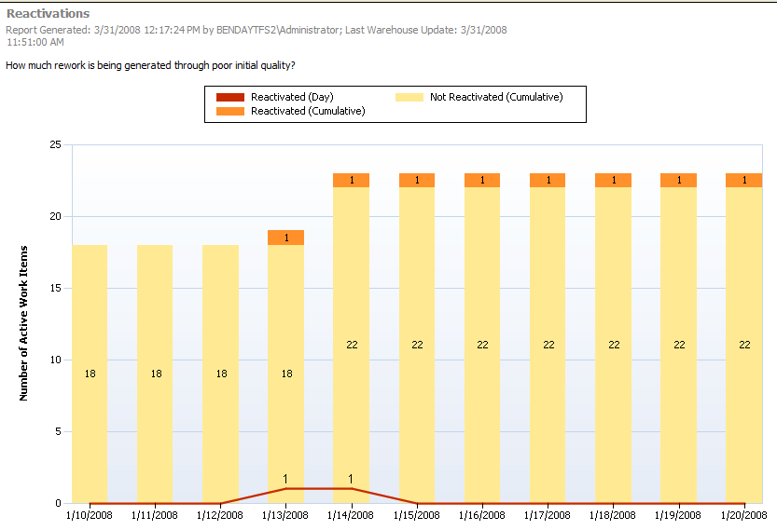
Reactivations

Slide 25
Report: Reactivations
Shows initial quality
Does work that’s “done” stay done?

Slide 26
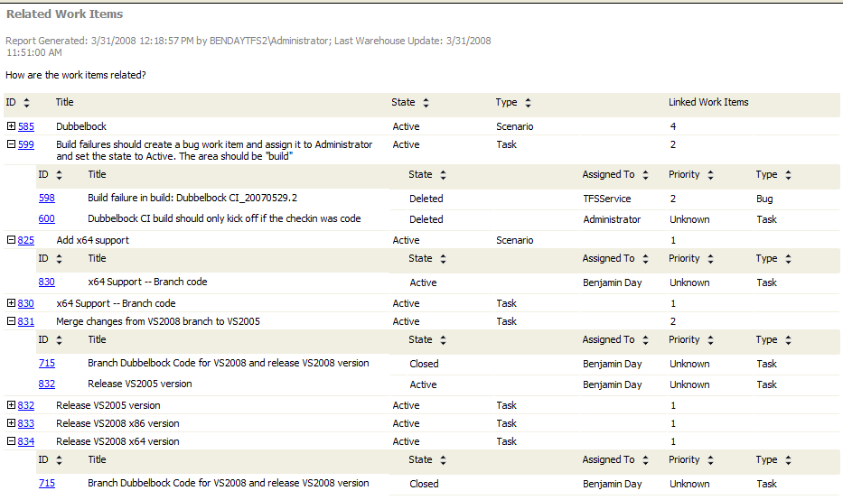
Related Work Items

Slide 27
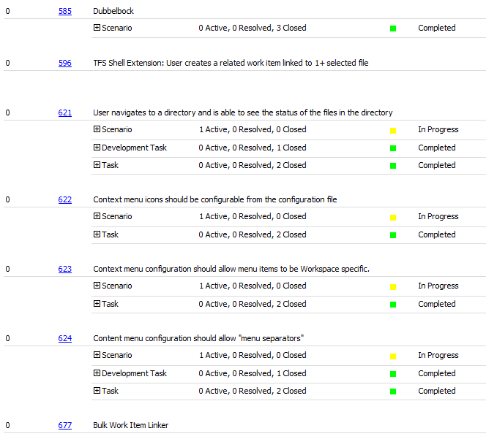
Scenario Details

Slide 28
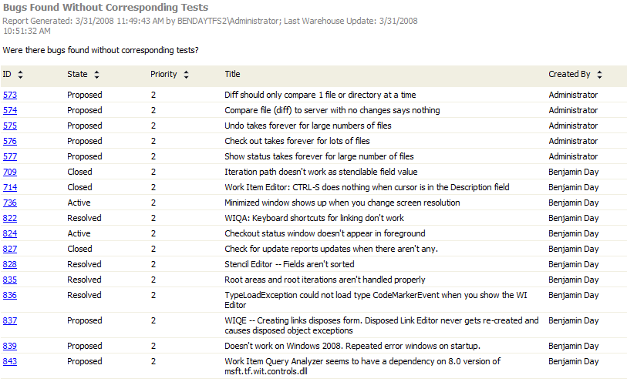
Bugs Found Without Corresponding Tests

Slide 29
Report: Bugs Found Without Corresponding Tests
Shows how good your unit test coverage is
High number of bugs found → need more tests

Slide 30
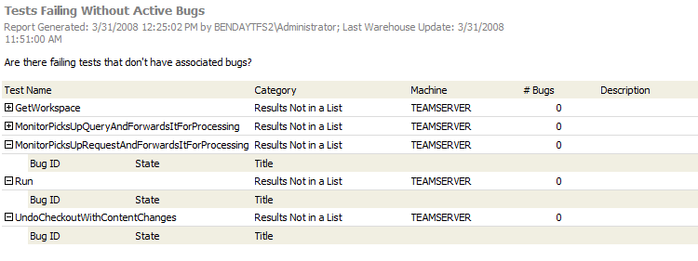
Tests Failing Without Active Bugs

Slide 31
The Cube

Slide 32
Fact? Dimension? Measure?
Fact Table
Represents something that has happened
Mostly foreign key values
Example: “Current Work Item” lists all work item IDs
All TFS facts have ID, Logical Tracking Id, LastUpdatedTime, LastUpdatedBy, TrackingId
Dimension
Human readable data
Think “lookup table” for Facts
Measure
Field of data on a Fact table

Slide 33
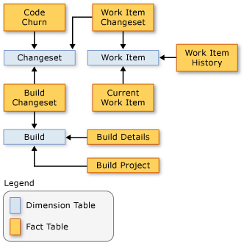
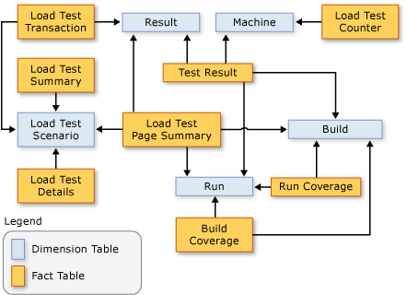
Facts to Dimensions
From http://msdn2.microsoft.com/ en-us/library/ms244707(VS.80).aspx

Slide 34
Fact Tables
Table | Description
Current Work Item | Current values for each work item
Work Item History | History of changes to each work item
Build Details | Info about each build
Code Churn | Should be called: “Changeset Info”
Build Coverage | Code coverage for each build for each assembly (dll, exe)
Build Project | Should be called: “Build Source Code Info”
Work Item Changeset | Relates work items to source control (Work Item → Code Churn)

Slide 35
Fact Tables 2
Table | Description
Run Coverage | Code coverage for each unit test execution NOTE: this is a block of tests not individual tests
Test Result | Result of the test
Load Test Counter
Load Test Details
Load Test Page Summary
Load Test Summary
Load Test Transaction

Slide 36
Dimension Tables
Table | Description
Date | Row for each day with multiple formats
File | Row for each file in source control
Changeset | Row for each changeset
Build | Row for each build
Build Flavor | “Debug”, “Release”, etc.
Build Quality | “Unexamined”, “Rejected”
Build Status | State descriptions for the build “Build Initializing”, “Compilation Started”, etc.
Area | System.AreaPath in multiple formats plus change tracking
Iteration | System.IterationPath in multiple formats plus change tracking
Person | Row for each person, group
Team Project | Row for each Team Project (current and deleted)

Slide 37
Dimension Tables 2
Table | Description
Work Item | Row for each revision
Run | Row for each test execution in a build
Result | Should be call “Individual Test Execution” Result of each unit test in a run includes test name, error message
Test Result | Results per Run
Assembly | Should be called “Tested Assembly”
Outcome | Test result description referenced by Test Result (“Error”, “Failed”, “Passed”, etc)
Platform | “Any CPU”, “.NET”
Machine | Machine executing a build
Test Category | Name of the test list

Slide 38
Dimension Tables 3
Table | Description
Load Test Counter
Load Test Page Summary
Load Test Scenario
Load Test Transaction Dimension

Slide 39
SQL REPORT BUILDER

Slide 40
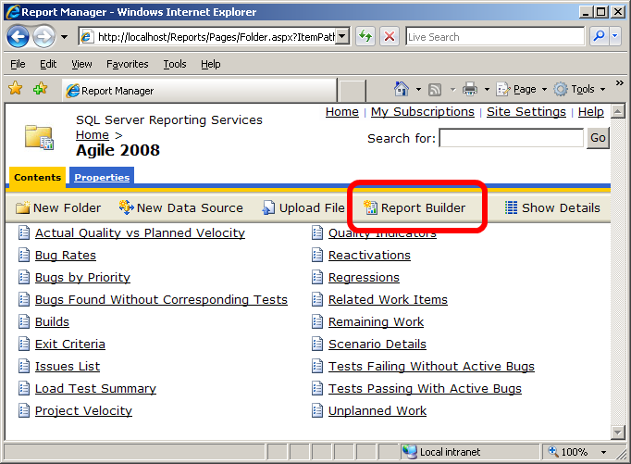
SQL Report Builder
http://tfs_name/Reports
Click Report Builder
Assumes that you’ve created a Model

Slide 41
Demo
Using Report Builder
Build: Checkin Policy Overrides Report
Build: View Latest Changesets

Slide 42
How to break FIX stuff
The Canned Reports

Slide 43
How to break the reports
Add new System.State values
Default states in Agile: Active, Resolved, Closed
What if you need more?
Proposed, Deleted, Assigned

Slide 44
Remaining Work Becomes Inaccurate

Slide 45
Reports that use System.State
Actual Quality vs Planned Velocity
Bug Rates
Bugs By Priority
Quality Indicators
Reactivations
Remaining Work
Scenario Details
Tests Passing With/Without Active Bugs

Slide 46
Edit the canned reports
Install Business Intelligence Design Studio
aka. “BIDS”
On SQL Server 2005 installer
Plugin to Visual Studio 2005
Export your TFS process template
Create a “Report Server Project” in VS2005
Import the *.rdl’s from TFS into the project
Adjust the data sources
(pull hair out for a while…just for giggles)
Enjoy.

Slide 47
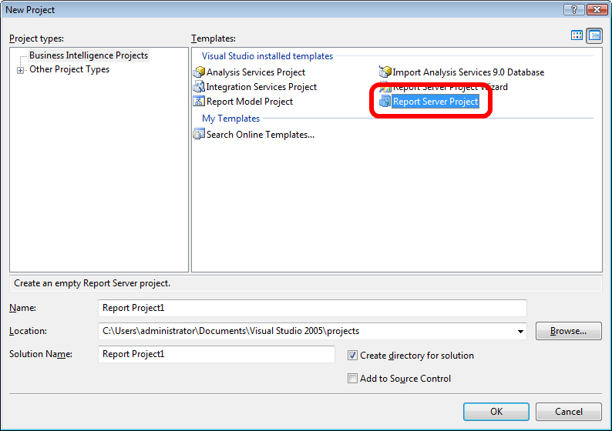
Report Server Project

Slide 48
Demo
Create a project to edit the canned reports
Fix the Remaining Work Report
Publish back it to the server

Slide 49
Ad-hoc reports with Excel
Hidden Stuff

Slide 50
Access Cube From Excel
Connect to the cube through Analysis Services
Develop adhoc reports
Open Excel
Go to Data tab
Get External Data from Other Sources
Add connection info
Connect to “Perspective” or “Cube”

Slide 51
Perspectives vs Cube
Cube = the whole thing
“Team System”
Perspective = simplified view of the cube
Only available on SQL Enterprise Edition
“Build”
“Code Churn”
“Code Coverage”
“Current Work Item”
“Load Test”
“Test Result”
“Work Item History”

Slide 52
Demo
Connect to the Warehouse with Excel
Create “Burn Down” chart in Excel
Create Work Items by Person and Area

Slide 53
About the speaker
Owner, Benjamin Day Consulting, Inc.
Email: benday@benday.com
Web: http://www.benday.com
Blog: http://blog.benday.com
Trainer
Visual Studio Team System, Team Foundation Server
Microsoft MVP for C#
Microsoft VSTS/TFS Customer Advisory Council
Leader of Beantown.NET INETA User Group

