Slide 1
How to be a C# ninja in 10 easy steps
Benjamin Day

Slide 2
About: Benjamin Day
Brookline, MA
Consultant, Coach, Trainer
Microsoft MVP for Visual Studio ALM
Team Foundation Server, Software Testing, Architecture, Windows Azure
TechEd, VSLive, DevTeach
Visual Studio Magazine, Redmond Developer News
Scrum.org Classes
Professional Scrum Developer (PSD)
Professional Scrum Foundations (PSF)
www.benday.com
benday@benday.com
@benday

Slide 3
Professional Scrum at Scrum.org
Professional Scrum Product Owner
Professional Scrum Master
Professional Scrum Developer
.NET or Java
Product Owners
Executives
Scrum Masters
Architects
Business Analysts
DB Specialists
Designers
Developers
Testers
Professional Scrum Foundations
Everyone

Slide 4
Why did I write this talk?

Slide 5
Top 10 things

Slide 6
The List.
Be humble
Object-orientation
Write less code
Value Types vs. Reference Types
Exceptions
Generics
Collections
IDisposable, using, & garbage collection
LINQ
Lambda Expressions

Slide 7
Bonus Item: Coming soon
.NET 4.5
async / await

Slide 8
Some extras.
Virtual, override, & new()
Tune out the “static”
Partial classes & methods
Covarience contravariance
Named parameters
Optional parameters
Dynamic keyword

Slide 9
Be humble.

Slide 10
Be humble.
Software is complex.
We developers…
…want to please
…think we’re awesome
…almost always underestimate

Slide 11
Tips.
Keep it simple.
Expect to make mistakes.
Not everyone will understand your abstractions.
Favor maintainability over “slickness”.
Write unit tests. Lots of unit tests.

Slide 12
“C# doesn’t do Xyz. C# sucks.”
Lesson I learned.
There’s a reason it’s built that way.
Don’t fight it.
Embrace it.
Learn from the design.

Slide 13
Remember Object-Orientation

Slide 14
Object-Oriented Principles
4 tenets
Encapsulation
Polymorphism
Inheritance
Abstraction
INTERVIEW QUESTION!

Slide 15
Write less code

Slide 16
Save some typing.

Slide 17
Less is more. (as long as it’s readable)

Slide 18
Everything you write has to be maintained.

Slide 19
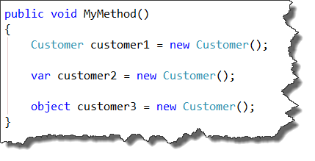
var vs. object

Slide 20
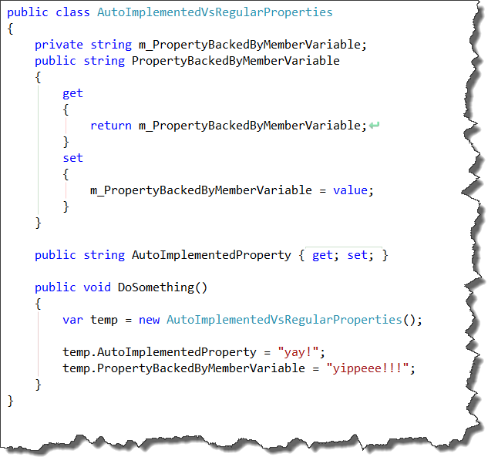
Auto-Implemented Properties

Slide 21
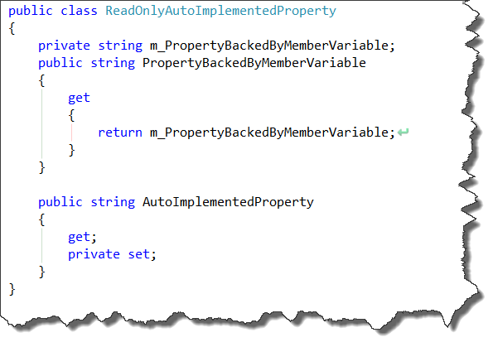
Read-Only Auto-Implemented Properties

Slide 22
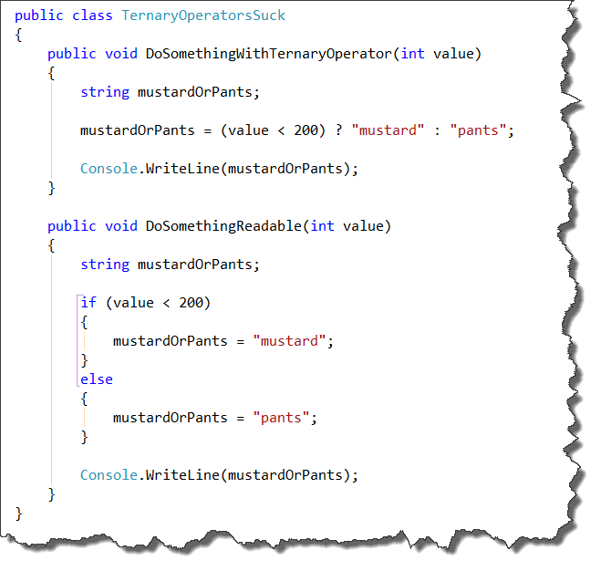
Avoid ternary operators

Slide 23
Value types vs. reference types

Slide 24
Whuh?
Value Types
Reference Types
Non-object types
Stored in memory “stack”
int, long, char, byte, etc.
float, double
decimal
bool
User-defined
Structs
Enumerations
Object types
Stored in memory “heap”
Variables are “pointers” to memory location
INTERVIEW QUESTION!

Slide 25
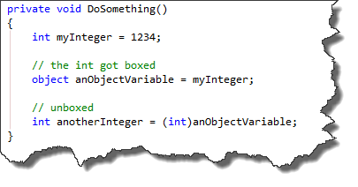
Boxing and Unboxing
Boxing
Process of wrapping a value type in an object reference
Unboxing
Converting a boxed value type object back into an value type variable
INTERVIEW QUESTION!

Slide 26
Exception Handling

Slide 27
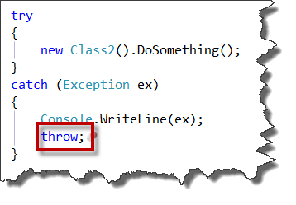
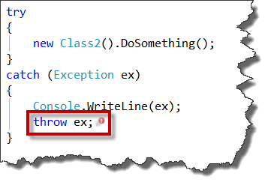
Throw vs. throw ex
throw;
throw ex;
INTERVIEW QUESTION!

Slide 28
(code demo)

Slide 29
generics

Slide 30
What are generics?
Syntax that allows you to use similar functionality with different types in a type-safe way
Implementation is the same
Data types are different

Slide 31
ViewModelField<T>
DomainObjectManager<T>

Slide 32
Collections

Slide 33
What is a Collection?
Data type for organizing lists of objects
Similar to an array

Slide 34
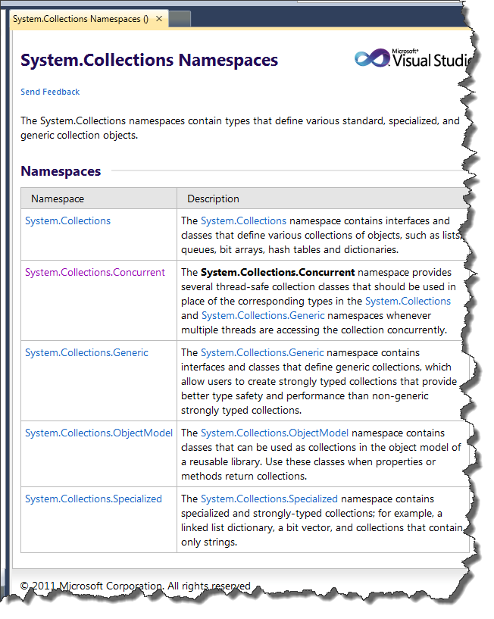
Part of the .NET framework
5 namespaces

Slide 35
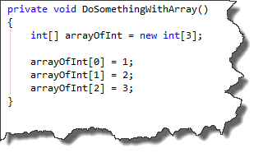
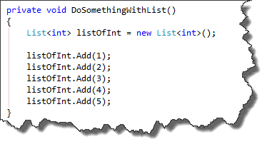
Array vs. List<T>
Array
List<T>
Size defined when created
Automatically expands

Slide 36
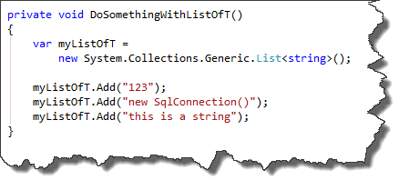
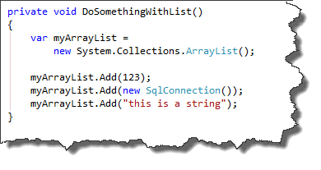
ArrayList vs. List<T>
ArrayList
List<T>
Not type-safe
Everything is an object
Watch out for boxing / unboxing
Type-safe
Everything must be an instance of T
INTERVIEW QUESTION!

Slide 37
Idisposable, Using, and Garbage Collection

Slide 38
What is Garbage Collection?
Background process in .NET
Determines when an object is not needed
Deletes it “automagically”
Frees up memory
You worry much less about memory management.

Slide 39
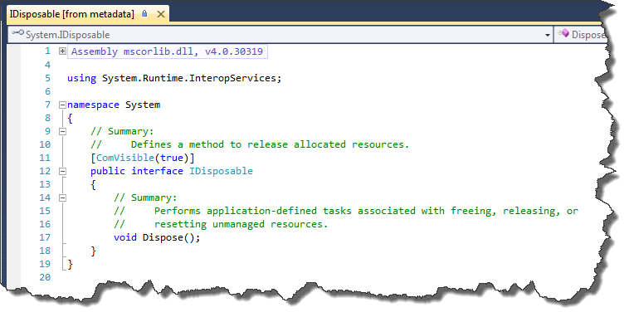
IDisposable

Slide 40
IDisposable: Custom Cleanup
Gets called when the Garbage Collector is disposing your object
Add custom logic
For example, close any open database connections

Slide 41
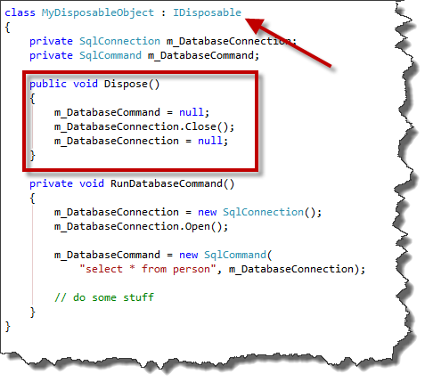

Slide 42
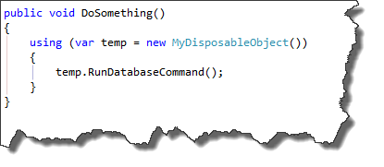
What does the ‘using’ statement do?
Wraps instance of IDisposable for block of code
Instance is disposed automatically at the end of the code block
INTERVIEW QUESTION!

Slide 43
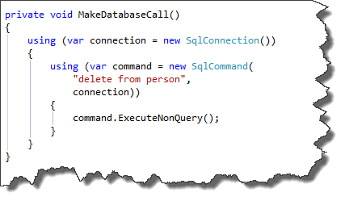
Wrap database connections in ‘using’ blocks
Most database classes implement IDisposable

Slide 44
Why should you wrap calls to database object in ‘using’ statements?
INTERVIEW QUESTION!

Slide 45
Hint: Wrap Enterprise Library Data Access Block in using() {}

Slide 46
LINQ

Slide 47
LINQ
Language-Integrated Query
Enables SQL-like querying of objects via IEnumerable<T>

Slide 48
LINQ Stuff
Operators
Useful functions
select
from
where
orderby
FirstOrDefault()
First()
Min()
Max()
Count()
Skip()
Take()
Reverse()
Sum()

Slide 49
(Code Demo: LinqSample.cs)

Slide 50
Lambda expressions

Slide 51
What’s a “lambda expression”?
Anonymous functions
Helpful for delegates
INTERVIEW QUESTION!

Slide 52
(Code Demos: LambdaExpressionSample.cs & LambdaExpressionForm.cs)

Slide 53
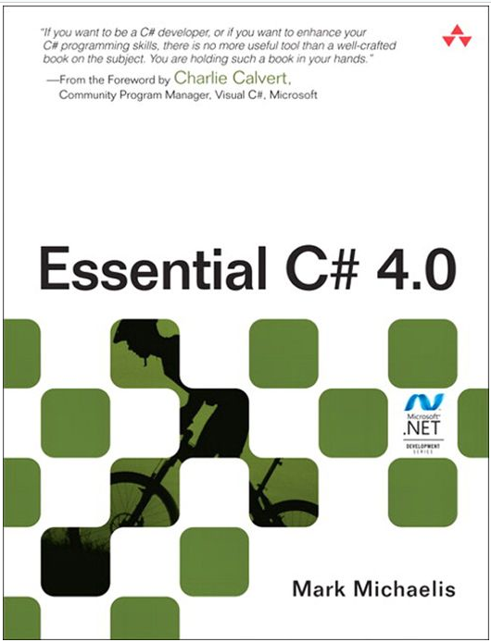
Additional Reading
Essential C# 4.0 by Mark Michaelis
Great overview of the language

Slide 54
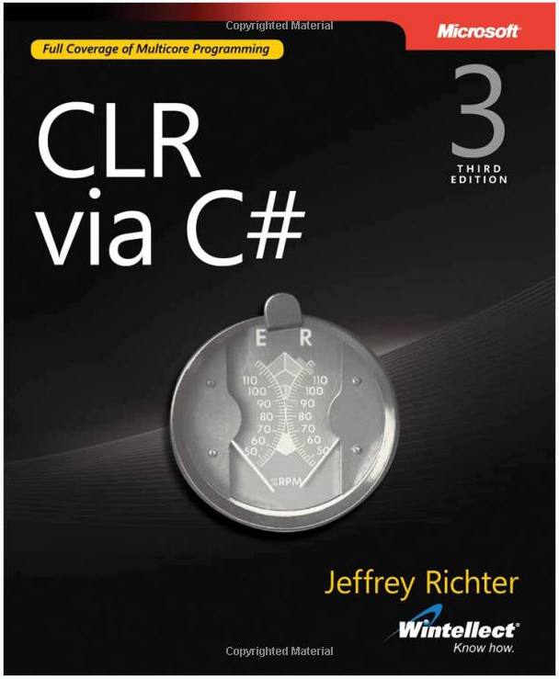
Additional Reading
CLR via C# by Jeffrey Richter
What’s going on under the hood of C# and the .NET Framework

Slide 55
The List.
Be humble
Object-orientation
Write less code
Value Types vs. Reference Types
Exceptions
Generics
Collections
IDisposable, using, & garbage collection
LINQ
Lambda Expressions

Slide 56
Thank you.
www.benday.com | benday@benday.com

