Slide 1
Win & Web App Installers with WiX
Benjamin Day
Level: Intermediate

Slide 2
About the speaker
Owner, Benjamin Day Consulting, Inc.
Email: benday@benday.com
Web: http://www.benday.com
Blog: http://blog.benday.com
Trainer
Visual Studio Team System, Team Foundation Server
Microsoft MVP for C#
Microsoft VSTS/TFS Customer Advisory Council
Leader of Beantown.NET INETA User Group

Slide 3
What is an installer?
Usually an MSI
MicroSoft Installer
Bundles all your files into a single package
Handles the logic of setting up your app on a machine

Slide 4
Options for installing your app
Simple (aka. No installer)
XCopy Deployment
Distribute a zip file
Uncomfortable
Visual Studio Setup & Deploy Packages
Full-featured
InstallShield
WiX
WISE

Slide 5
What does an installer do for you?
Install & Uninstall
Registry keys
Folder paths
COM registration
Update logic
Program menu shortcuts
Way too hard for a non-technical user
Non-repeatable without an automated installer

Slide 6
What is WiX?
Windows Installer Xml
Xml to describe Windows Installer MSI’s
Developed by Microsoft
Around 1999
Released to Open Source in April 2004
Mostly written by Rob Mensching
http://robmensching.com/
http://wix.sourceforge.net/

Slide 7
WiX is not dead
Sourceforge site hasn’t been updated for about a year
Weekly drops are still getting made http://wix.sourceforge.net/releases/
Visual Studio setup is written in WiX
WiX will be included as a project type in Rosario

Slide 8
How do you get started?
Go to http://wix.sourceforge.net/releases/
Download & install the latest 3.0.* release

Slide 9
Ok. Now what?

Slide 10
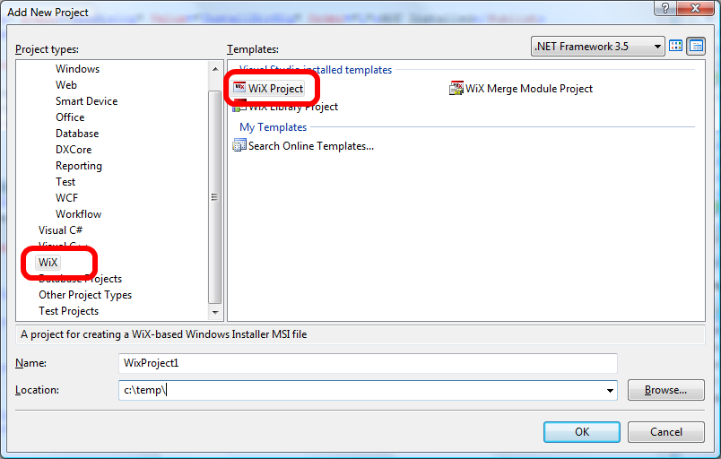
WiX Projects in Visual Studio
“Votive”

Slide 11
Votive Projects
Allow you to add, edit
Intellisense
Compiler support
Defines variables to reference solution/project paths
Source control

Slide 12
Votive Project Types
WiX Project
Generates *.msi
WiX Merge Module
Installer referenced from another installer
Generates *.msm
WiX Library Project
Re-usable pieces of WiX

Slide 13
Other tools that comes with WiX
Heat.exe
Jump starts WiX creation
Candle.exe
WiX Compiler
Light.exe
WiX Linker
Dark.exe
Decompiler
Smoke.exe
Validator

Slide 14
Basic WiX Elements
<Wix> - Root element w/ Namespaces
<Product> - What you’re installing
<Directory>, <File>
<Feature>, <Component>
<UI>, <Dialog>
<Fragment>
<Property>
“Refs”

Slide 15
<Product>
Id
Guid for this product release
UpgradeCode
Guid to identify the product
Language
Language code
US English = 1033
Manufacturer
Name
Version

Slide 16
Demo
Use heat.exe to create a basic installer
Put the installer into a Votive project
Fix the file paths to use
$(var.ProjectName.ProjectDir)
$(var.ProjectName.TargetDir)
$(var.SolutionDir)

Slide 17
Defining the user interface
<UI>
Defines user interface features
<UIRef Id=“ui_name”>
Reference a UI
WixUIExtension.dll
Pre-defined UI Sequences
WixUI_Mondo, WixUI_Advanced, WixUI_FeatureTree, WixUI_InstallDir, WixUI_Minimal
Decent documentation at http://www.wixwiki.com

Slide 18
Demo
Set the UI to WixUI_FeatureTree

Slide 19
Customizing Folder Structure
<Directory>
Id
There are lots of reserved paths in WiX
Name = friendly name
Some Reserved Paths
ProgramFilesFolder
StartMenuFolder
DesktopFolder
AppDataFolder
WindowsFolder
http://msdn2.microsoft.com/ en-us/library/aa372057.aspx

Slide 20
Directories, Components, & Files
Directories have Components
Components have Files
<Directory>→ <Component> → <File>
<Component>
A piece of the app
Can be installed or not installed

Slide 21
Demo
Use a <Component> to optionally install debug symbols (.pdb’s)
Use a WiX preprocessor variable to only redistribute pdb’s in a Debug build

Slide 22
Program Menu Shortcuts
<Shortcut> is a child of <File>
Directory attribute = where the shortcut appears
StartupFolder
ProgramMenuDir
TIP: To simplify installer development, create a quick uninstall shortcut

Slide 23
Create Start Menu Folders & Shortcuts
Add a <Directory> reference to any directory you’ll be using
Reserved Id’s
Id=“ProgramMenuFolder”
Id=“ProgramMenuDir”
Id=“StartupFolder”
Add a reference to the directory Id on the <Shortcut>
<Shortcut Directory=“directory_id” />

Slide 24
BUG FIX!
If you have a <File> with a <Shortcut> it must be the first <File> in the <Component>
If not, the shortcut will point to the wrong file
Read more here: http://blog.benday.com/archive/ 2007/08/09/23155.aspx

Slide 25
Add Icons To Shortcuts
Add an <Icon> after </Directory>
<Icon Id=“MyIcon.ico" SourceFile="$(var.proj_name.ProjectDir)\ MyIcon.ico" />

Slide 26
Demo
Create the program menu directory structure
Add shortcuts to the exe
Add an uninstall shortcut
Specify an <Icon> for the shortcuts

Slide 27
More UI Customization
Many customizations are available using existing <WixVariable>’s
Customize the EULA
Supply path to .rtf document <WixVariable Id=“WixUILicenseRTF” Value=“” />
Supply your own banner for the installer
Create a 493 x 58 pixel bitmap (BMP)
Include it in your Votive project
<WixVariable Id=“WixUIBannerBmp” Value=“” />

Slide 28
Still More UI Customization
Launch your app with a custom action
ExitDialog has a hidden checkbox
Add
<CustomAction> that points to WixShellExec
Set
WIXUI_EXITDIALOGOPTIONALCHECKBOX
WIXUI_EXITDIALOGOPTIONALCHECKBOXTEXT
WixShellExecTarget
Hook into the “DoAction” event on ExitDialog
Add reference to WixUtilExtension.dll

Slide 29
Demo
Customize the EULA
Add the banner
Add a “run me now” custom action

Slide 30
Installing Web Apps
Use heat.exe to start
HINT: don’t bother with the “website” option
Edit the directory references
Add reference to WixIisExtension.dll
Point <iis:WebVirtualDir>
Set <iis:WebApplication>

Slide 31
Tips for Deploying Web Apps
Put each app in a separate wxs file
IIS Service Host
Web UI
Admin Web UI
During Dev/QA, use WiX to simplify deployment of releases
Generate and build WiX during TFS Team Build
Use <Target Name=“AfterCompile”> or <Target Name=“PackageBinaries”>

Slide 32
Demo
Create a web app installer

Slide 33
What’s the setup.exe for?
Setup.exe is the “bootstrapper”
Installs pre-requisites
Bootstrapper Manifest Generator
By David Guyer
VS2005 http://www.codeplex.com/bmg
VS2008 (beta) http://www.codeplex.com/bmg/Release/ ProjectReleases.aspx?ReleaseId=10652

Slide 34
Create a setup.exe bootstrapper with BMG
Run BMG
Choose New Project…
Choose “MSBuild” project type
Point BMG at your existing MSI
Choose the prerequisites
On the Packages tab
Choose download source
Run “Build”

Slide 35
Demo
Use Bootstrapper Manifest Generator to make a setup.exe

Slide 36
Updating existing apps
UpgradeCode
Major Upgrades
Minor Upgrades
Uninstall existing versions

Slide 37
Best Practice
Set Id=“*”
Auto generates a new id on compile
Never change your upgrade code

Slide 38
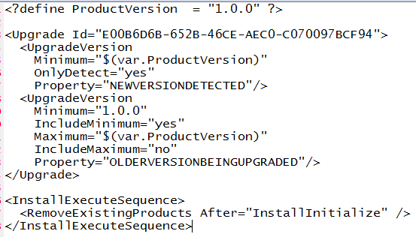
Upgrade Syntax
<Upgrade>
<UpgradeVersion>
<InstallExecuteSequence>
Set IncludeMaximum to “yes” to always uninstall

Slide 39
Tip for Vista
Force a UAC elevation prompt
<Property Id="ALLUSERS">1</Property>
Very helpful when you need to write to HKLM

Slide 40
Demo
Add a registry key in HKLM during setup
Run on Vista

Slide 41
Miscellaneous
ICE = Internal Consistency Evaluator
Find problems in your installer

Slide 42
About the speaker
Owner, Benjamin Day Consulting, Inc.
Email: benday@benday.com
Web: http://www.benday.com
Blog: http://blog.benday.com
Trainer
Visual Studio Team System, Team Foundation Server
Microsoft MVP for C#
Microsoft VSTS/TFS Customer Advisory Council
Leader of Beantown.NET INETA User Group

