Slide 1
Get Good at DevOps: Feature Flag Deployments with ASP.NET, WebAPI, & JavaScript
Benjamin Day
www.benday.com @benday

Slide 2
Benjamin Day
Brookline, MA
Consultant & Trainer
Scrum, DevOps, Team Foundation Server, Software Architecture & Testing
Microsoft MVP
Pluralsight Author
Scrum.org Trainer
@benday

Slide 3
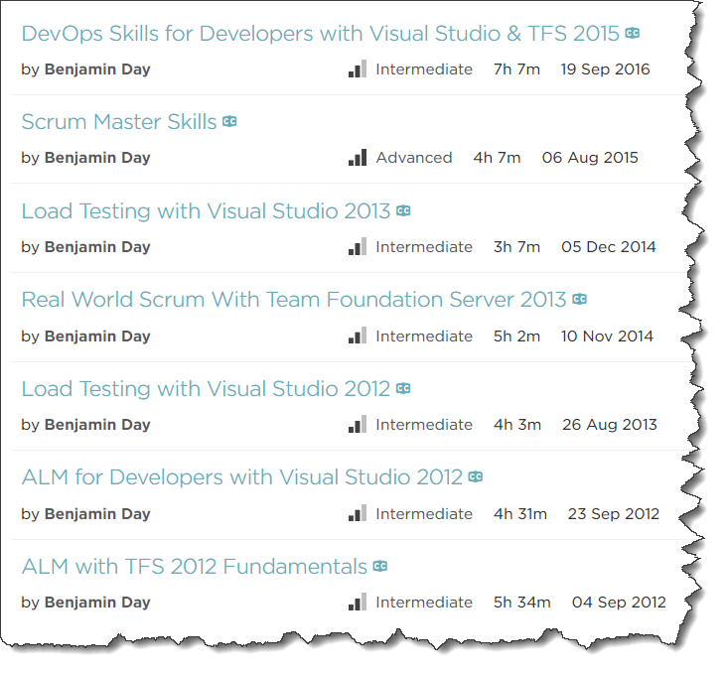
Pluralsight.com
Online courses
DevOps with TFS2017
Scrum Master Skills

Slide 4
Getting Started with Visual Studio Team Services (VSTS)

Slide 5
Architecting an ASP.NET Core MVC Application for Unit Testability Coming in ~November 2018

Slide 6
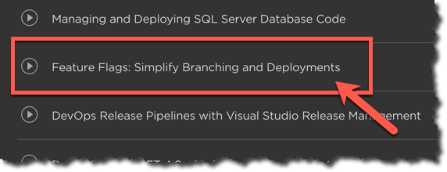
Want to see this talk and code again?
Pluralsight
DevOps Skills for Developers with Visual Studio and TFS2017
Feature Flags: Simplify Branching and Deployments

Slide 7
On with the show.

Slide 8
Software development is hard.

Slide 9
Software delivery is hard.

Slide 10
How do you get a feature into production?

Slide 11
Branching & Merging

Slide 12
Branching lets you work on similar, related code in isolation at the same time.

Slide 13
“So, I can go nuts and create 250 zillion branches and it’s a good idea?”

Slide 14
No.

Slide 15
A branch is an integration credit card.

Slide 16
For every branch, there’s a merge.

Slide 17
Merging can be expensive and painful.

Slide 18
Until everything’s integrated, it’s definitely not done.

Slide 19
Keep it simple.

Slide 20
Best Practice: Don’t Branch *
* - unless you absolutely have to

Slide 21
Integrate often.

Slide 22
The smaller the integration, the easier it is.

Slide 23
Typical Branching Structure
Main, Trunk, Origin, $/TeamProject/
Dev
Feature-x
Releases
v.1
v.2
v.3..n
Feature-y
Feature-z

Slide 24
Typical Branching Structure
Main, Trunk, Origin, $/TeamProject/
Dev
Feature-x
Feature-y
Feature-z
Releases
v.1
v.2
v.3..n
Main
Beginning of everything
Ultimate integration point
Dev
Integration point for a release
Feature-*
Features are developed here
Releases (v.*)
Snapshot of what goes to production
Source of hot fixes

Slide 25
Typical Release Flow
MERGE
Main, Trunk, Origin, $/TeamProject/
Dev
Feature-x
Feature-y
Feature-z
Releases
v.*
Merge Features to Dev
Verify / fix whatever is in Dev
Merge to Main
Create new Release branch
V.1123414
2016.03.15
Deploy to production servers
MERGE
BRANCH

Slide 26
Typical Release Flow
MERGE
Main, Trunk, Origin, $/TeamProject/
Dev
Feature-x
Feature-y
Feature-z
Releases
v.*
Whatever gets merged to Main gets released
Code-based release model
MERGE
BRANCH

Slide 27
Typical Release Flow: Bad News
MERGE
Main, Trunk, Origin, $/TeamProject/
Dev
Feature-x
Feature-y
Feature-z
Releases
v.*
Merge Feature X
Easy
Commit the merge
Merge Feature Y
Ok
Commit the merge
Merge Feature Z
HARD
REALLY REALLY HARD
Turns out that Feature X isn’t done
Major surgery to get this undone

Slide 28
Typical Release Flow: Bad News
MERGE
Main, Trunk, Origin, $/TeamProject/
Dev
Feature-x
Feature-y
Feature-z
Releases
v.*
Feature branch integrations are not going well
Getting merged code to “play nice” means manually un-doing work that’s already been committed
Cherry picking
DELAYS

Slide 29
Typical Release Flow: Bad News, Change of plans
MERGE
Main, Trunk, Origin, $/TeamProject/
Dev
Feature-x
Feature-y
Feature-z
Releases
v.*
Merge Features to Dev
Commit the merge
Boss wants only Feature X and Z to go live
Merge Feature X and Z to Main
Painful, annoying, & tedious
Commit the merge

Slide 30
Releases based on source control can be a real drag.

Slide 31
Releases based on Source Control
Whatever is in the branch goes to production
Whatever is in production is live
Pros:
Simple to understand
Cons
Coordination can be a real headache

Slide 32
Feature flags

Slide 33
Feature Flags
“Feature toggles”
Configuration-based releases
Define configuration values for features
This is a feature flag
On / Off
Wrap feature code inside of checks for feature flag
If it’s on, it runs
Deploy whatever doesn’t cause problems
Turn on whatever is ready
Much less emphasis on branching & merging
Easier to schedule
The features are already deployed
Turn them on when you’re ready

Slide 34
Feature Flag: Benefits
New levels of flexibility
Deploy multiple versions of the same feature side-by-side
New user interfaces and old user interfaces at same time
Private betas
New features for only certain users
A/B testing
Which version do people prefer?
Rollback
Not working?
Performance problems?
Great for Scrum & DevOps

Slide 35
Feature Flag: Drawbacks
Adds complexity to the code
Can get confusing
Technical debt
Should be removed at some point
For example, running two version of a feature should be temporary
Sometimes turns into an excuse to ship garbage
Lack of focus on being truly “Done”

Slide 36
DevOps?

Slide 37
DevOps
How are you developing, delivering, deploying, & monitoring?
“What is the process of getting a developer’s changeset from check-in to production? How long does that take?”
If you want to go fast, start automating
Automation removes hard / tedious stuff
Automation provides reliability
Automation helps you do more and go faster
Stability, Reliability, Repeatability, Release-ability

Slide 38
DevOps increases the speed of feedback.

Slide 39
DevOps increases the speed of mistakes.

Slide 40
DevOps increases the speed of feedback.
Product Ownership in an Agile world is all about experimentation
Each new feature is an experiment
Build as little code as possible → Minimum Viable Product (MVP)
Ship it & gather feedback
That’s the experiment
You don't always want to commit to these experiments.

Slide 41
“Go big or go home” vs. “Go small and quietly and go home if it doesn’t work”

Slide 42
Technical Stuff

Slide 43
Want to see this talk and code again?
Pluralsight
DevOps Skills for Developers with Visual Studio and TFS2017
Feature Flags: Simplify Branching and Deployments

Slide 44
Implementation Tips
Create an IFeatureManager interface
Each feature flag should be a Boolean property
NO MAGIC STRINGS!
Use Dependency Injection for your IFeatureManager
Makes it very easy to find and remove later

Slide 45
DEMOS
Basic feature flag
Search
Two features side-by-side
Undeploy a feature that’s getting bad reviews
Private beta

Slide 46
A feature flag is (probably) technical debt.

Slide 47
Any specific feature flag should eventually be removed.

Slide 48
Your feature flag system is forever. The individual feature flags are temporary.

Slide 49
Watch out for technical debt.

Slide 50
Any last questions?

Slide 51
Thanks. benday@benday.com | www.benday.com

