Slide 1
Design for Testability: Mocks, Stubs, Refactoring, and User Interfaces
Benjamin Day

Slide 2
Who’s this Benjamin Day guy?
Brookline, MA
Consultant, Coach, & Trainer
Microsoft MVP for Visual Studio ALM
Team Foundation Server, Software Testing, Scrum, Software Architecture
Scrum.org Classes
Professional Scrum Developer (PSD)
Professional Scrum Foundations (PSF)
www.benday.com, benday@benday.com, @benday

Slide 3
Have you heard of Scrum.org?

Slide 5
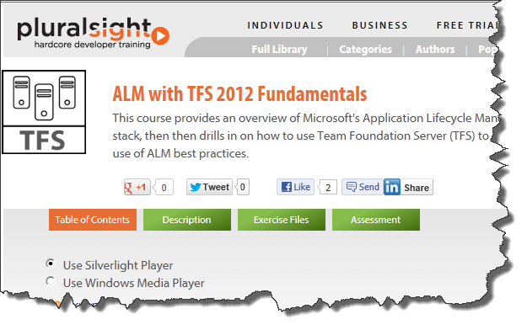
http://www.pluralsight.com/training/Courses/TableOfContents/alm-fundamentals

Slide 6
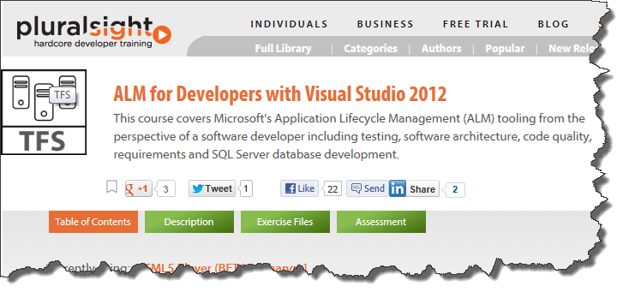
http://pluralsight.com/training/Courses/TableOfContents/alm-for-developers

Slide 7
Agenda
Quick ‘what’ and ‘why’
Dependency Injection
Mocks & Stubs
Databases, Web Services
User Interface Testing

Slide 8
WHAT & WHY

Slide 9
What is Test Driven Development?
Develop code with proof that it works
Code that validates other code
Small chunks of “is it working?”
Small chunks = Unit Tests
“Never write a single line of code unless you have a failing automated test.”
Kent Beck, “Test-Driven Development”, Addison-Wesley

Slide 10
Why Use TDD?
High-quality code
Fewer bugs
Bugs are easier to diagnose
Encourages you to think about…
…what you’re building
…how you know you’re done
…how you know it works
Less time in the debugger
Tests that say when something works →
Easier maintenance, refactoring
Self-documenting

Slide 11
Maximize Your QA Staff
You shouldn’t need QA to tell you your code doesn’t work
Unit tests minimize the pointless bugs
“nothing happened”
“I got an error message” + stack trace
NullReferenceException
QA should be checking for:
Stuff only a human can test
User Story / Product Backlog Item
Bug assigned to you should add business value

Slide 12
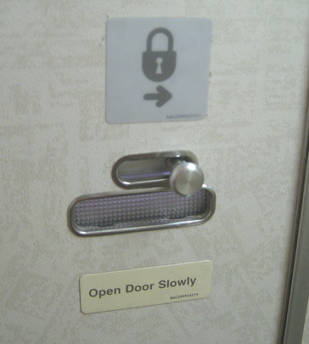
How would you test this?

Slide 13
What is Design For Testability?
Build it so you can test it.
How would you test this?
Do you have to take the plane up for a spin?
http://www.flickr.com/photos/ericejohnson/4427453880/

Slide 14
Dependency Injection

Slide 15
What is Dependency Injection?
Classes advertise their dependencies on the constructor
Need to save & load Person objects? Add a person data access instance on the constructor.
Helps you to design for testability
Related to the Factory Pattern
Keeps classes loosely coupled

Slide 16
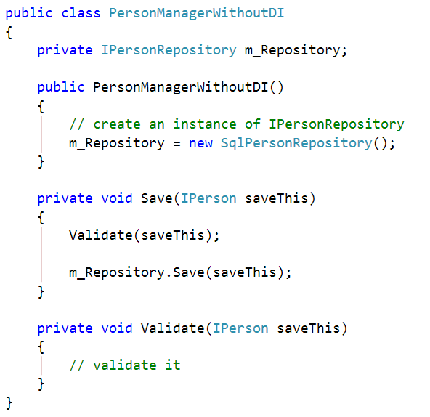
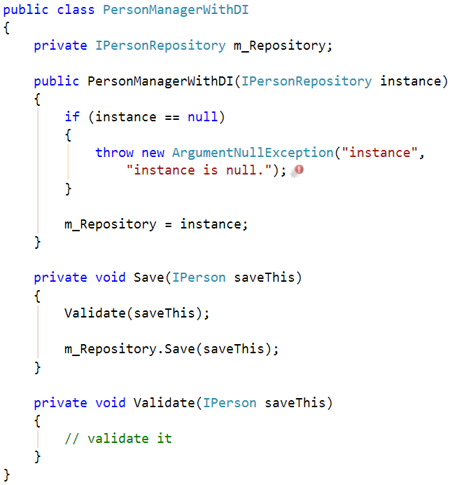
Advertise Dependencies on Constructor
Less Awesome
Now With More Awesome

Slide 17
Try a DI framework
Can make life easier
There are half-zillion frameworks out there.
NInject, Unity, Castle, Structure Map, etc.
(They’re pretty much all the same.)
TIP: hide the existence of your DI framework from the rest of your application.

Slide 18
Why does DI help with testability?
Helps you focus on the testing task at hand
Only test what you’re trying to test. Skip everything else.
Makes interface-driven programming simple
Interface-driven programming + DI lets you use mocks and stubs in your tests.

Slide 19
Mocks & stubs

Slide 20
Mocks vs. Stubs vs. Dummies vs. Fakes
Martin Fowler http://martinfowler.com/articles/ mocksArentStubs.html
Dummy = passed but not used
Fake = “shortcut” implementation
Stub = Only pretends to work, returns pre-defined answer
Mock = Used to test expectations, requires verification at the end of test

Slide 21
Mocking with the Visual Studio 2012 Fakes Framework.

Slide 22
Demo 1: Stub With VS2012 Fakes

Slide 23
Demo 2: Test Exception Handling
Look at some existing code
Refactor for testability
Use VS Fakes to trigger the exception handler

Slide 24
Databases & SErvices

Slide 25
Avoid End-to-End Integration Tests
Does a good test…
…really have to write all the way to the database?
…really have to have a running WCF service on the other end of that call?
…really need to make a call to the mainframe?

Slide 26
Reminder: Only test what you have to test.
To test this latch, do you have to take the plane up for a spin?
http://www.flickr.com/photos/ericejohnson/4427453880/

Slide 27
The Repository Pattern
“Mediates between the domain and data mapping layers using a collection-like interface for accessing domain objects.”
http://martinfowler.com/eaaCatalog/repository.html
Encapsulates the logic of getting things saved and retrieved

Slide 28
Person Repository

Slide 29
Demo 3: Repository Pattern
Simplify database (or web service) unit test with a repository

Slide 30
User interfaces

Slide 31
User Interfaces: The Redheaded Stepchild of the Unit Testing World
Not easy to automate the UI testing
Basically, automating button clicks
UI’s almost have to be tested by a human
Computers don’t understand the “visual stuff”
Colors, fonts, etc are hard to unit test for
“This doesn’t look right” errors
The rest is:
Exercising the application
Checking that fields have the right data
Checking field visibility

Slide 32
My $0.02
Solve the problem by not solving the problem
Find a way to minimize what you can’t automate

Slide 33
The Solution.
Keep as much logic as possible out of the UI
Shouldn’t be more than a handful of assignments
Nothing smart
Real work is handled by the business tier
Test the UI separate from everything else

Slide 34
Design Patterns for UI Testability
Model-View-Controller (MVC)
ASP.NET MVC
Model-View-Presenter (MVP)
Windows Forms
ASP.NET Web Forms
Model-View-ViewModel (MVVM)
Silverlight
WPF
Windows Phone 7

Slide 35
Service Layer Pattern
“Defines an application’s boundary with a layer of services that establishes a set of available operations and coordinates the application’s response in each operation.”
-Randy Stafford
From “Patterns Of Enterprise Application Architecture” by Martin Fowler, Randy Stafford, et al. Chapter 9

Slide 36
Model View Presenter (MVP)

Slide 37
Model View Presenter (MVP)

Slide 38
The Common Tiers
Presentation tier
ASP.NET
Windows Forms
WPF
WCF Service
The “View” of MVP
Presenter Tier
Handles the "conversation" between the presentation tier implementation and the business tier
Defines the “View” Interfaces
“Presenter” in MVP
Business tier
Business object interfaces
Business objects
The “Model” in MVP
Business facades
Manipulate business objects
Handle requests for CRUD operations
Data Access Tier
Data Storage Tier
SQL Server

Slide 39
View interfaces
Interface represents the fields manipulated through the UI
ASPX Page or Windows Form Implements the interface
Interface’s properties wrap UI widgets
ICustomerDetailView.CustomerName → m_textboxCustomerName.Text
Use a stub represent the UI
Write unit tests to test the functionality of the presenter
Avoid business objects → favor scalars

Slide 40
The Presenter
Service Layer Pattern
Wrap larger operations that are relevant to each UI page/screen interface
InitializeBlank(ICustomerDetailView)
View(ICustomerDetailView)
Save(ICustomerDetailView)
Since each page implements the interface, pass the page reference to the facade

Slide 41
Model View Presenter (MVP)

Slide 42
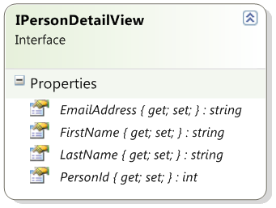
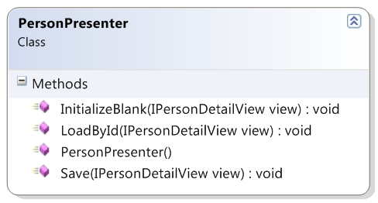
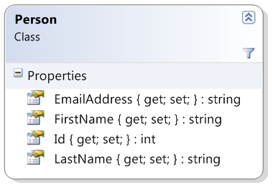
Designing the UI for Testability
PersonDetailView.aspx

Slide 43
Why is this more testable?
Each page/screen only has to get/set the value from interface property into the right display control
UI does not know anything about business objects
Doesn’t know about any details of loading or saving
Doesn’t have to know about validation
All this logic goes into the Presenter and testable via unit test

Slide 44
Demo 4
Refactor to UI Interfaces

Slide 45
Agenda
Quick ‘what’ and ‘why’
Dependency Injection
Mocks & Stubs
Databases, Web Services
User Interface Testing

Slide 46
Thank you.
www.benday.com | benday@benday.com

