Slide 1


Zero to Hero: Untested to Tested with Visual Studio Fakes
Benjamin Day
@benday

Slide 2






Benjamin Day
Brookline, MA
Consultant, Coach, & Trainer
Microsoft MVP for Visual Studio ALM
Scrum, Team Foundation Server, Software Testing,
Software Architecture
Scrum.org Classes
  Professional Scrum Master (PSM)
  Professional Scrum Developer (PSD)
  Professional Scrum Foundations (PSF)
www.benday.com, benday@benday.com, @benday

Slide 3
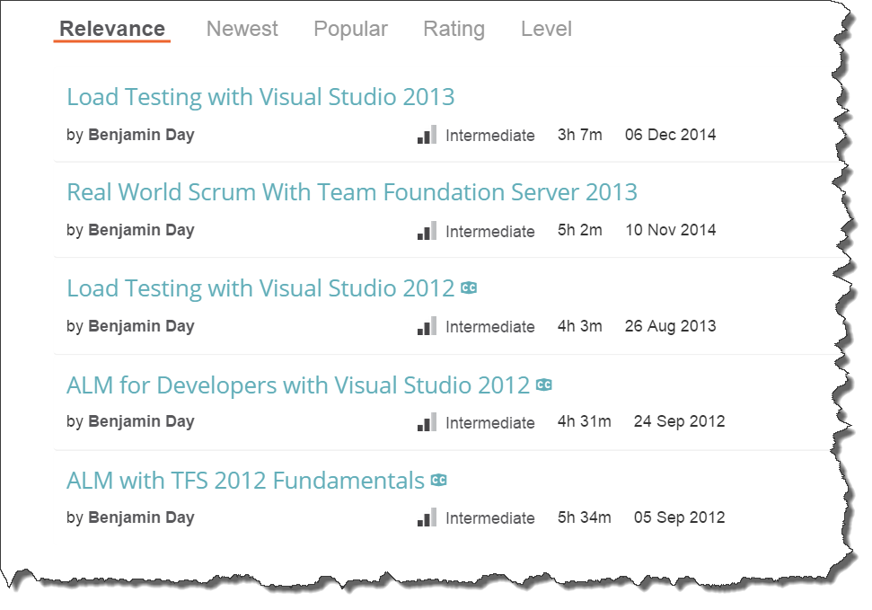
Got ?

Slide 4
Let’s start out with a story.

Slide 5
In the beginning, I was a
Pascal & C programmer.

Slide 6
Not object-oriented.

Slide 7
Wrote my code on paper.

Slide 8
99% of my day in the debugger.

Slide 9
Everyone else spent that much time in the bugger, too.

Slide 10
Then I become a
VB6 & Java programmer.

Slide 11
Object-oriented.

Slide 12
50% of my time in the debugger.

Slide 13
Why so much less time in the debugger?

Slide 14
Bugs are encapsulated.

Slide 15
I learn C#.

Slide 16
Still 50 % of my life in the debugger.

Slide 17
Then someone tells me about this thing called “unit testing.”

Slide 18
“Well, that’s the dumbest thing
I’ve ever heard.”

Slide 19
“I don’t need another test harness for my code.”

Slide 20
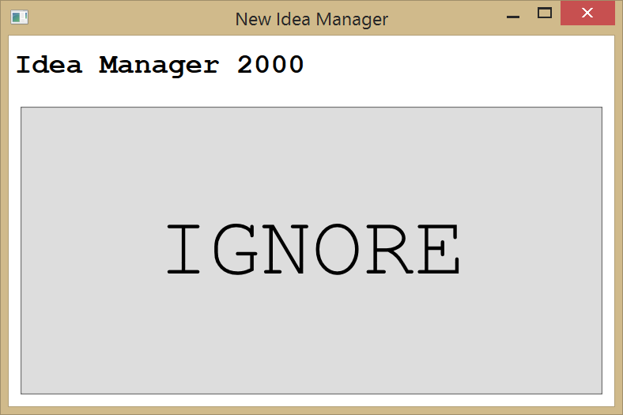
(Ignore.)
“(click)”

Slide 21
(Ignore.)

Slide 22
At some point, someone paid me to write a course on unit testing.

Slide 23
(cha-ching.)

Slide 24
“You think about what you’re trying to build before you build it?”

Slide 25
“Then you write an automated test that doesn’t even compile?!?!”

Slide 26
Make the code pass, then you have a failing automated test.

Slide 27
“Then you code until the test passes?”

Slide 28
“Well, that’s just plain stupid.”

Slide 29
(Have you noticed that I'm resistant to change and unsettled by new things?)

Slide 30
Then I start to like it.

Slide 31
My debugger time drops to near zero.

Slide 32
IMHO, time in the debugger is time
I’m not writing features.

Slide 33
Before unit testing, long lists of defects.

Slide 34
After unit testing, practically no defects.

Slide 35
I’m delivering much higher quality code to my customers.

Slide 36
Happier customers.

Slide 37
They’re no longer telling me my stuff is broken.

Slide 38
Since then, I’m obsessed with making sure my code is testable.

Slide 39
(…and now the real world comes crashing in like a dinosaur-killing meteorite out of the emptiness of space.)

Slide 40


Slide 41


Slide 42
We don’t always get to write our code from scratch.

Slide 43
We sometimes have to build on top of existing code.

Slide 44
Existing.

Slide 45
Awful.

Slide 46
Just-this-side-of-barely-working.

Slide 47
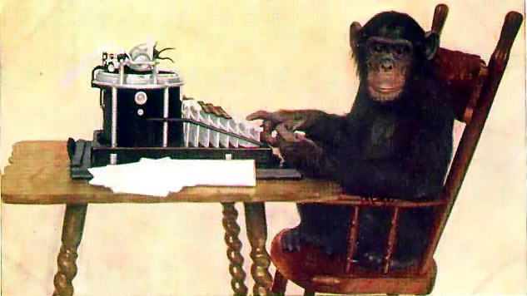
Code.
You’re welcome.
Notes:
http://en.wikipedia.org/wiki/File:Monkey-typing.jpg

Slide 48
Ever tried to add unit tests to an existing application?

Slide 49
Darned close to impossible.

Slide 50
Why is it so hard to add tests?
When you build with TDD…
  Lots of design decisions…
  You always pick the testable one.
  Assumes automated tests.
  End result: testable & maintainable.
When you build without TDD…
  Lots of design decisions…
  You picked the one that gets it done.
  Testing is focused on integration testing & QA.
  Assumes human-driven tests.
  End result: not that testable.

Slide 51
What makes it not testable?
Tightly coupled
Hidden or embedded dependencies
Required data & databases
Usually, insane amount of setup code for the test.

Slide 52
Design goals in a testable system
(Testable, obviously.)
Code to interfaces rather than concrete types
Single Responsibility Principle (SRP)
Dependency Injection
Layered

Slide 53
Here’s a best practice…

Slide 54
Design For Testability.

Slide 55
Build your app so that it can be tested.

Slide 56
“Sure, Ben. That’s nice.
So. Uhhh. Yah.
We didn’t do that.
What’s next?”

Slide 57
Design For Testability.
Refactor For Testability.

Slide 58
It’s called a unit test.
Small units of functionality
Tested in isolation
Unit Test != Integration Test
If you designed for testability, you (probably) can test in isolation.
If you *didn’t*, testing that monolithic app looks scary.

Slide 59

“How am I supposed to test THAT?!”
http://www.pdphoto.org/PictureDetail.php?mat=&pg=8307

Slide 60
1. You have to break it apart.

Slide 61
2. You’ve got to start somewhere.

Slide 62
The Microsoft Fakes Framework
Helps you to unit test in isolation
Uses delegates & lambda expressions
Shims
  (Magic.)
  Substitute hard-coded types with *something else* at runtime
Stubs
  Helps if you’re interface-driven
  Creates default() implementations of an interface
    including properties & methods

Slide 63
Stubs vs. Shims
Stubs
  If you’ve got interfaces already
  You’re building from scratch
  If you want to save yourself some typing
  You aren’t battling “sealed” and “static” keywords
Shims
  Stuff is hopelessly stuck together
  Stuff is hopelessly non-testable
  You’re supporting legacy code
Suggestion: Shims are not a long-term solution
  Use them to help you refactor and actually fix the testability problem

Slide 64
Demo 1:
Write the PersonDataAccess unit test
Use shims to replace PersonDataAccess

Slide 65
Techniques for going from 0 to hero
Remember: you don’t *have to* start writing tests for existing code.
  Although that might be a good idea.
Write tests for new features.
Write tests for changes to existing features.
Fix bugs with unit tests.

Slide 66
Things to think about.

Slide 67
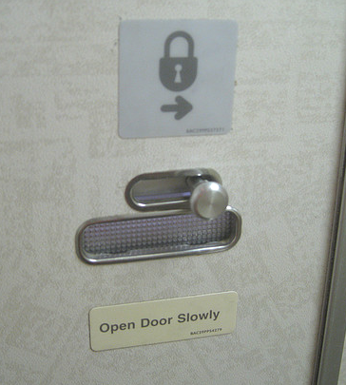
How would you test this?
http://www.flickr.com/photos/ericejohnson/4427453880/

Slide 68
What is Design For Testability?
Build it so you can test it.
How would you test this?
Do you have to take the plane up for a spin?
http://www.flickr.com/photos/ericejohnson/4427453880/

Slide 69
try
{
DoSomething();
} catch(SqlServerOutOfDiskSpaceException ex)
{
SaveTheUniverseFromDestruction();
}

Slide 70
Demo 2:
Use Stubs to get code coverage on exceptions
Use Stubs to save typing / pain

Slide 71
Dependency Injection.

Slide 72
What is Dependency Injection?
Classes advertise their dependencies on the constructor
  Need to save & load Person objects?
  Add a person data access instance on the constructor.
Helps you to design for testability
Related to the Factory Pattern
Keeps classes loosely coupled

Slide 73


http://lostechies.com/derickbailey/files/2011/03/DependencyInversionPrinciple_0278F9E2.jpg

Slide 74
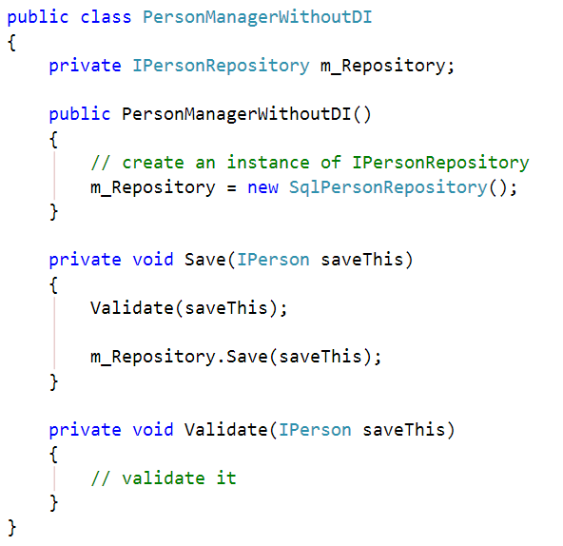
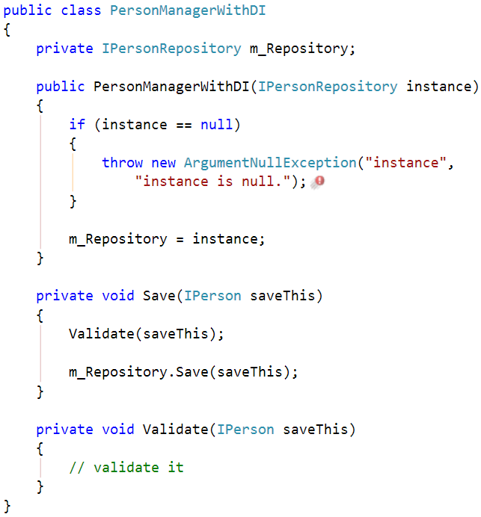
Advertise Dependencies on Constructor
Less Awesome
Now With More Awesome

Slide 75
Why does DI help with testability?
Helps you focus on the testing task at hand
  Only test what you’re trying to test. Skip everything else.
Makes interface-driven programming simple
Interface-driven programming + DI lets you use mocks and stubs in your tests.

Slide 76
Demo 3:
Refactor Person Manager to use a Logger DI parameter
Add verification to Logger calls with Stubs

Slide 77
Avoid End-to-End Integration Tests
Does a good test…
…really have to write all the way to the database?
…really have to have a running WCF service on the other end of that call?
…really need to make a call to the mainframe?

Slide 78
Reminder:
Only test what you have to test.
To test this latch, do you have to take the plane up for a spin?
http://www.flickr.com/photos/ericejohnson/4427453880/

Slide 79
The Repository Pattern
“Mediates between the domain and data mapping layers using a collection-like interface for accessing domain objects.”
  http://martinfowler.com/eaaCatalog/repository.html
Encapsulates the logic of getting things saved and retrieved

Slide 80
Demo 4:
Refactor Person Manager to use a Repository
Convert tests to use in-memory fake database

Slide 81
What’s some of the dullest code to write that’s the most error prone?

Slide 82
Service data transfer objects to/from Domain objects.

Slide 83
ADO.NET objects to/from Domain objects.

Slide 84
This code probably sits in an object named *DataAccess, right?

Slide 85
*DataAccess makes a call into the database and then converts the data into Domain objects, right?

Slide 86
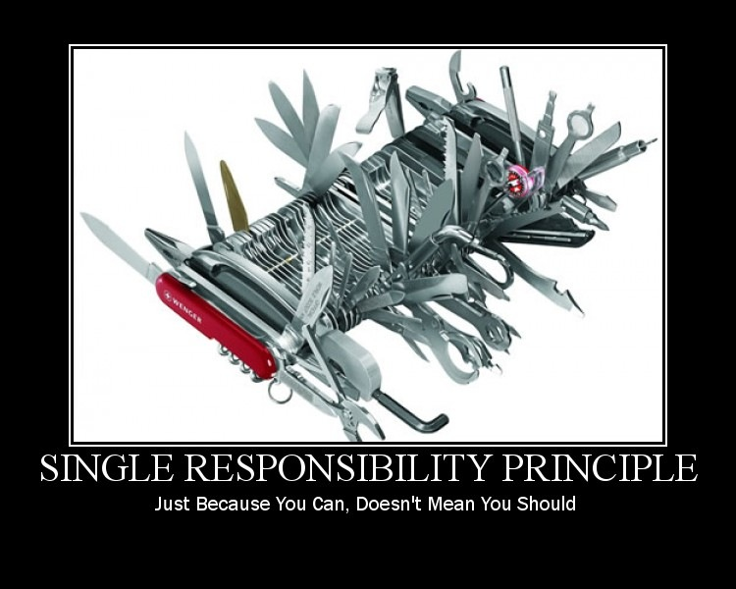
http://lostechies.com/derickbailey/files/2011/03/SingleResponsibilityPrinciple2_71060858.jpg

Slide 87
1) It makes the database call
2) It converts the objects

Slide 88
Adapter Pattern.

Slide 89

Repository Pattern &
Adapter Pattern.

Slide 90
Demo 5:
Refactor to Repository & Adapter

Slide 91
Summary
Tightly-coupled app
Type replacement to make it testable
Stubs to save typing and cover exceptions
Eliminate or reduce dependency on database from tests
Refactor to Repository & Adapter

Slide 92
Any last questions?

Slide 93
Thank you.
www.benday.com | benday@benday.com

