Slide 1



How to Fix a Troubled Project
Tapping the brakes on that rolling dumpster fire. 🔥🔥🔥
Benjamin Day
www.benday.com | @benday

Slide 2




Benjamin Day
Brookline, MA
Consultant & Trainer
Rental Chief Technology Officer
Therapist for Teams
Scrum, DevOps, Azure,
Team Foundation Server,
Software Architecture & Testing
Microsoft MVP
Pluralsight Author
Scrum.org Trainer
@benday

Slide 3
Implementing Scrum with Azure DevOps
New!

Slide 4
Azure DevOps Services Fundamentals
Scrum Master Skills

Slide 5
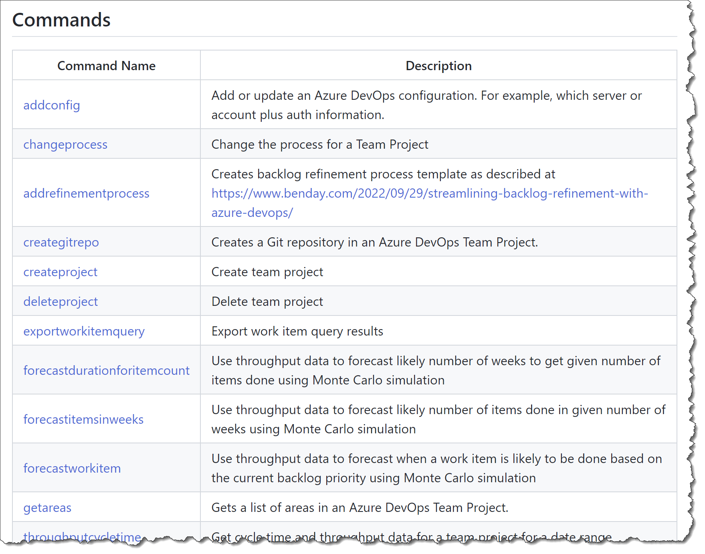
Azure DevOps Utilities (azdoutil) https://github.com/ benday-inc/azdoutil
Free!

Slide 6
On with the show.

Slide 7
Failing project
Troubled project
At-risk project
Something ain’t right.

Slide 8
Perception
  Credibility problems
  Customers or management thinks the project is in trouble
  Team is in trouble
  Suspicion
Reality
  Technical team thinks it’s going poorly
  Team isn’t sure it can be done
Two types of ‘fail’

Slide 9
Perception vs. Reality
People / Expectation Management Problems
Technical Issues

Slide 10
1-2-4-All
What causes projects to get into trouble?
Why do projects fail?
12 minutes
Troubled Projects

Slide 11
Nothing getting done
Buggy or low quality
Unhappy stakeholders
Wobbly requirements
No idea when you’ll be done
  No data
Perception problems
Trust problems
Credibility problems
Causes of Troubled Projects

Slide 12
At the core…
Someone thinks that their “needs” aren’t going to be met
  They’re afraid
Answer: address the fear
  Or acknowledge the fear
  Or confirm the fear
People / Expectation Management Problems

Slide 13
The team isn’t sure it can/will be done
No progress
Exploding technical risk
Answer:
  Minimize work in progress (WIP)
  Focus on Done
  Simplify and/or fix the technical problems
  DevOps practices
Technical Issues

Slide 14
How we talk is how we think.

Slide 15
Words matter.

Slide 16
When you’re trying to fix a project, talk about what you’re going to do rather than stop doing.

Slide 17
Create motion.
Communicate with motion.

Slide 18
Steps to fix it

Slide 19
When you’re in a hole, stop digging.

Slide 20
Consider killing the project
Stop making promises about dates
Define what Done means
Figure out what the top priority items are for the next 2 to 4 sprints
Minimize Work In Progress (WIP)
Flow Metrics
TO DO

Slide 21
Consider killing the project
Stop making promises about dates
Define what Done means
Figure out what the top priority items are for the next 2 to 4 sprints
Minimize Work In Progress (WIP)
Flow Metrics
Things to do

Slide 22
Consider killing the project
Stop making promises about dates
Define what Done means
Figure out what the top priority items are for the next 2 to 4 sprints
Minimize Work In Progress (WIP)
Start using Sprint Goals
Focus on delivering to Done
  Verify you have the right people on the team
  Hold the team accountable as a unit
Backlog refinement
Consider Scrum, Kanban, and/or Flow Metrics
Automated builds, tests, and releases
TO DO

Slide 23
Not going well?
Unhappy customers?
Not getting anything done?
Stuff you’re building is garbage?
Maybe you should just quit.
  Kill the project
  Or maybe even quit your job
Consider that the project is perhaps not worth saving
Step 1a:
Consider Killing the Project

Slide 24
Power move
Reframe / reconfirm that it’s worth doing
Why do you want this thing?
How will you know if it’s successful?
How will you know if it’s failed?
What are your top priority features?
  Helps to focus on what’s important
Step 1b:
Confirm that it’s worth continuing

Slide 25
“When am I going to get my stuff?”
Everyone wants to know this
Nothing makes customers more nervous than when you keep making promises on dates…
…and you keep missing those dates
They think you don’t know what you’re doing
  …and they’re probably not wrong
Step 2:
Stop Making Promises on Dates

Slide 26
Stop making promises you aren’t sure you can keep.
You need better data.

Slide 27
Why are your estimates wrong?
Complexity
Unknowns
Dependencies
Wishful thinking
Why are dates slipping?

Slide 28
The Dirty Little Huge Secret:
Your customers don’t really care about your estimates.

Slide 29
Your customers just want their done, working software.

Slide 30
Start making your customer(s) happy.

Slide 31
Give them something that’s done.

Slide 32
Train them that they’ll get chunks of ‘Done’ on a regular basis.

Slide 33
Consider killing the project
Stop making promises about dates
Define what Done means
Figure out what the top priority items are for the next 2 to 4 sprints
Minimize Work In Progress (WIP)
Start using Sprint Goals
Focus on delivering to Done
  Verify you have the right people on the team
  Hold the team accountable as a unit
Backlog refinement
Consider Scrum, Kanban, and/or Flow Metrics
Automated builds, tests, and releases
TO DO

Slide 34
#1: Unclear definition of “Done”
#2: Not focusing on Done /
Too Much Work in Progress (WIP)
#3: Product Backlog Problems
Top Reasons that projects get into trouble
($0.02)

Slide 35
Create a Definition of Done (DoD)
Everything it takes to call a requirement done
  100% done
  “Potentially shippable”
  No more additional work required
Write it down!
Discuss it regularly
Consider sharing it with your bosses, customers, & stakeholders
  They might not understand it
  They might have suggestions
Step #3:
Define ‘Done’

Slide 36
There’s a lot more to your DoD than
“the code compiles and is checked in.”

Slide 37
Sample Definition of Done (DoD)
Development / Coder
Testing, Deployment, Ops
Code is written with unit tests
Unit tests have a minimum of 75% code coverage
Code has been merged to Main
Code compiles and unit tests pass when run as part of an automated build
Database schema objects are checked in to version control
Database upgrade script is written and in version control
Code reviewed by someone other than the original author
Written QA test plan
Tested with QA test plan by someone other than the original author
Deployed and tested in Staging environment
Automated UI tests are
written and pass
No Severity 1 or 2 bugs
Reviewed by Product Owner
Passes acceptance criteria for the PBI
Known deployment & rollback plan
Deployment plan reviewed by Ops
Database changes reviewed by DBAs
Load tested
Deployed to Production

Slide 38
Estimation
Forecasting
Work in Progress
Team communication
Communication with stakeholders
QA Testing / Defect Tracking
DevOps
Version Control / Branching & Merging
Definition of Done touches everything

Slide 39
Your team creates it’s Definition of Done
Now your team knows if something is Done
This also mean they know when something is NOT done
  Hint: most of the time, stuff isn’t Done
Your stakeholders, customers, bosses now understand what you mean when you say ‘Done’
DoD → Transparency

Slide 40
It’s a lot of work to get to ‘Done’
If you ship features that aren’t 100% done, your customers think you’re shipping garbage.
Your customers DO NOT UNDERSTAND the difference between ‘partially done’ and ‘done’
  Creates a horrible credibility problem
  Makes communication about status INSANELY hard
Most of the time, stuff isn’t ‘Done’

Slide 41
Another way of saying this…
Prioritize your work
Make it clear what the priorities are
Step #4:
Fix your
Product Backlog

Slide 42
List of requirements
Product Backlog represents the vision for the features and priorities for the product
Product Backlog Item =
feature / requirement
Product Backlog

Slide 43
Not enough backlog
Unclear definition of what the Product is
  (…and what it ISN’T)
Unclear understanding of “Ready” product backlog
PBIs only make sense to tech people
  Doesn’t tell a story
  Not readable by mere mortals
  Task-y PBIs
  No acceptance criteria
Product Backlog Problems

Slide 44
You want your customers to be clear what you’re working on and why.

Slide 45


So…uhhh…what are you working on?

Slide 46
Blah blah blah sql server blah blah reactive blah blah cloud deploy blah blah blah security blah blah stuff
So…uhhh…what are you working on?

Slide 47
Name | Size
Update payment system to convert USD to Bitcoin | 8
Fix layout and click problems on Safari on iPhone 6 | 3
Update payment system to support ApplePay | 5
Request PDF receipt delivered by email for past purchase | 2
Generate report to see orders by payment type | 3
Update payment system to take PayPal payments | 5
Mark transaction for fraud audit | 8
Upgrade site layout to support Internet Explorer 11 | 8
Refund in-store mobile purchase from administrator device | 5
Fix bugs related to jQuery upgrade (Defect #123, #456, #321, etc.) | 3
Fix bugs related to declined transactions using debit cards (Defect #132, #821) | 3
Book pre-paid appointment | 2
Request PDF summary of all purchases for date range | 3
Redeem gift card for in-store purchase | 2
Redeem gift card for mobile purchase | 3
Update public-facing website to use new logo and color scheme | 5
Update paid-user website to use new logo and color scheme | 3
Update Android app to use new logo and color scheme | 2
Update iOS app to use new logo and color scheme | 1
Real-time in-store purchase notification for managers on mobile admin app | 5
Request printed receipt after in-store mobile purchase | 5
Feature XYZ | 13
Feature ABC | 13
Use mobile camera to scan UPC and do a price comparison | 21
Create a lasting world peace | 21
Feature QWERTY | 21
Reporting dashboard for iOS & Android | 40
Federated Identity using external authentication providers | 40
Add membership card to Apple Wallet | 13
Use mobile camera to scan UPC for product and add to cart for in-store purchase | 8
Complete in-store mobile purchase | 8
Teach cats to do tax preparation | 80
RFID-based inventory control system | 80
Migrate application hosting to external cloud provider | 40
Talking unicorns | 120
So…uhhh…what are you working on?
BOOOOOOM!!!!
This.

Slide 48
Step 5:
Minimize Work in Progress
Do less at once to do more overall.

Slide 49
Productivity vs. Waste
"Quality Software Management: Vol. 1 System Thinking“, Gerald Weinberg (1992), Page 284

Slide 50
Visualize Your Progress: Scrum Board
 | TO DO | IN PROGRESS | DONE
PBI A
PBI B
PBI C
Product
Backlog Items
Tasks

Slide 51
Scrum Board for the Sprint
 | TO DO | IN PROGRESS | DONE
Product
Backlog Item A
Status
PBI A
Product
Backlog Item B
Status
PBI B
Product
Backlog Item C
Status
PBI C

Slide 52
Scrum Board for the Sprint
 | TO DO | IN PROGRESS | DONE
PBI A
PBI B
PBI C

Slide 53

Scrum Board for the Sprint
 | TO DO | IN PROGRESS | DONE
PBI A
PBI B
PBI C

Slide 54
Scrum Board for the Sprint
 | TO DO | IN PROGRESS | DONE
PBI A
PBI B
PBI C

Slide 55
Scrum Board for the Sprint
 | TO DO | IN PROGRESS | DONE
PBI A
PBI B
PBI C

Slide 56


Scrum Board Danger
 | TO DO | IN PROGRESS | DONE
PBI A
PBI B
PBI C

Slide 57
Why is that so dangerous?

Slide 58
Too much work in progress.

Slide 59
‘Work In Progress’ commonly abbreviated as
‘WIP’.

Slide 60
Scrum Board Danger
 | TO DO | IN PROGRESS | DONE
PBI A
PBI B
PBI C

Slide 61
Sprint: Day 1 of 15
 | TO DO | IN PROGRESS | DONE
PBI A
PBI B
PBI C

Slide 62
Sprint: Day 2 of 15
 | TO DO | IN PROGRESS | DONE
PBI A
PBI B
PBI C

Slide 63
Sprint: Day 3 of 15
 | TO DO | IN PROGRESS | DONE
PBI A
PBI B
PBI C

Slide 64
Sprint: Day 4 of 15
 | TO DO | IN PROGRESS | DONE
PBI A
PBI B
PBI C

Slide 65
Sprint: Day 5 of 15
 | TO DO | IN PROGRESS | DONE
PBI A
PBI B
PBI C

Slide 66
Sprint: Day 6 of 15
 | TO DO | IN PROGRESS | DONE
PBI A
PBI B
PBI C

Slide 67
Sprint: Day 7 of 15
 | TO DO | IN PROGRESS | DONE
PBI A
PBI B
PBI C

Slide 68
Sprint: Day 8 of 15
 | TO DO | IN PROGRESS | DONE
PBI A
PBI B
PBI C

Slide 69
Sprint: Day 9 of 15
 | TO DO | IN PROGRESS | DONE
PBI A
PBI B
PBI C

Slide 70
Sprint: Day 10 of 15
 | TO DO | IN PROGRESS | DONE
PBI A
PBI B
PBI C

Slide 71
Sprint: Day 11 of 15
 | TO DO | IN PROGRESS | DONE
PBI A
PBI B
PBI C

Slide 72
Sprint: Day 12 of 15
 | TO DO | IN PROGRESS | DONE
PBI A
PBI B
PBI C

Slide 73
Sprint: Day 13 of 15
 | TO DO | IN PROGRESS | DONE
PBI A
PBI B
PBI C

Slide 74
Sprint: Day 14 of 15
 | TO DO | IN PROGRESS | DONE
PBI A
PBI B
PBI C

Slide 75
Sprint: Day 15 of 15 (in your dreams)
 | TO DO | IN PROGRESS | DONE
PBI A
PBI B
PBI C

Slide 76
Sprint: Day 14 of 15
 | TO DO | IN PROGRESS | DONE
PBI A
PBI B
PBI C

Slide 77


Sprint: Day 15 of 15 (in reality)
 | TO DO | IN PROGRESS | DONE
PBI A
PBI B
PBI C
Plenty left to do

Slide 78
What went wrong?

Slide 79
Too much WIP.
Not enough Done.

Slide 80
Most of the Sprint Looked like This
 | TO DO | IN PROGRESS | DONE
PBI A
PBI B
PBI C
Lots of
Work In Progress
0.00 Items are Done
0.00 PBIs are Done

Slide 81
A Better Approach to WIP
 | TO DO | IN PROGRESS | DONE
PBI A
PBI B
PBI C

Slide 82
A Better Approach to WIP
 | TO DO | IN PROGRESS | DONE
PBI A
PBI B
PBI C

Slide 83
Huge Benefit: Risk Management

Slide 84





Sprint: Day 5 of 15
 | TO DO | IN PROGRESS | DONE
PBI A
PBI B
PBI C

Slide 85
Sprint: Day 10 of 15
 | TO DO | IN PROGRESS | DONE
PBI A
PBI B
PBI C

Slide 86
Sprint: Day 13 of 15
 | TO DO | IN PROGRESS | DONE
PBI A
PBI B
PBI C

Slide 87
Sprint: Day 14 of 15
 | TO DO | IN PROGRESS | DONE
PBI A
PBI B
PBI C

Slide 88
Sprint: Day 15 of 15
 | TO DO | IN PROGRESS | DONE
PBI A
PBI B
PBI C

Slide 89
Where’s the good news in that?

Slide 90
Sprint: Day 15 of 15
At least you got one PBI done.
 | TO DO | IN PROGRESS | DONE
PBI A
PBI B
PBI C

Slide 91
Do less at once →
Decreased risk of delivering nothing in this Sprint

Slide 92
Doing less at once !=
Doing less overall

Slide 93
Same pile of work.
Different way of delivering it.

Slide 94
Whole team is going to work on one PBI as a team.

Slide 95
Helps team to focus.

Slide 96
Team’s focus is on details of a single PBI rather than details of a bunch of PBIs.

Slide 97
Step 6: Flow Metrics
Where’s my stuff?
Predict the future. Change the conversation. Save the world.

Slide 98

When am I going to get my stuff?

Slide 99
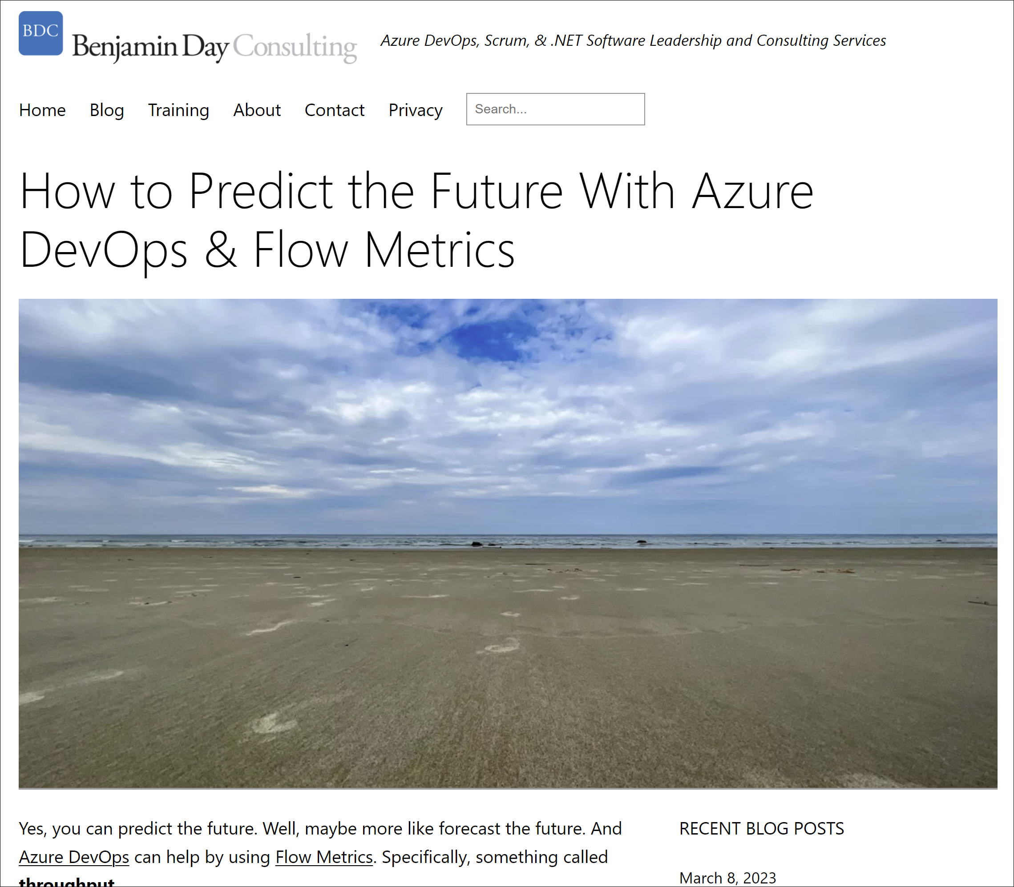
https://nday.be/go/02321

Slide 100

Ever tried to talk about your customer about
Story Points & Velocity?

Slide 101
Traditional Scrum & Agile metrics are hard to explain…and almost impossible to understand.

Slide 102
Story Points and Velocity don’t do a good job explaining our level of confidence.

Slide 103
Oh…and estimation sucks.

Slide 104
Predict the future with how you did in the past.

Slide 105
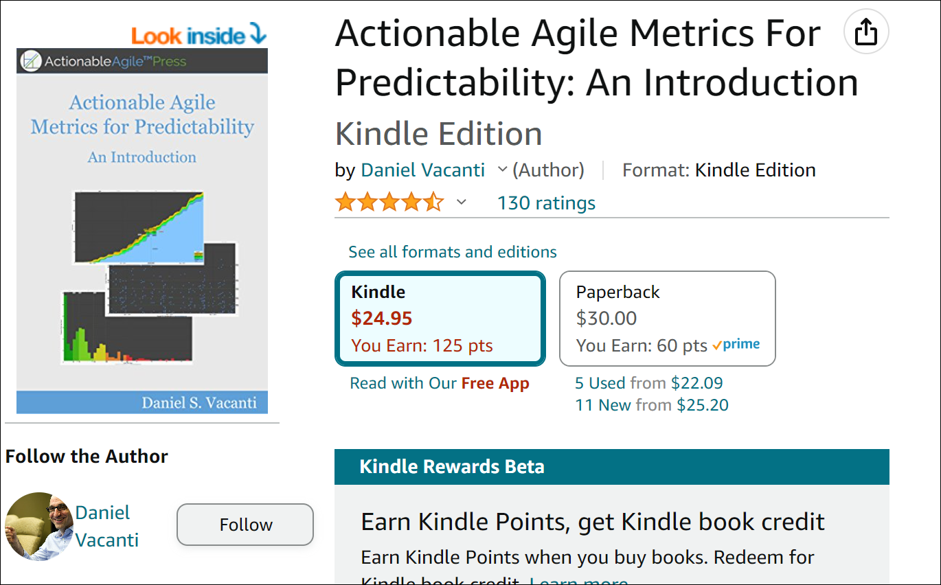

Slide 106
Dr. John Little
Average Cycle Time =
Average Work In Progress /
Average Throughput
Little’s Law

Slide 107
Amount of work items completed per unit of time
Measure of how fast items depart a process
Throughput

Slide 108
Amount of elapsed time that a work item spends as Work In Progress (WIP)
Cycle Time

Slide 109
“…the more things that you work on at any given time, the longer it is going to take for each of those things to finish.”
Daniel Vacanti
Actionable Agile Metrics for Predictability
Page 46

Slide 110
“In order to get stuff done faster, you need to work on less.”
Daniel Vacanti
Actionable Agile Metrics for Predictability
Page 46

Slide 111
Using AzdoUtil & Azure DevOps
https://github.com/benday-inc/azdoutil
Get our team’s Throughput
Forecast delivery of X items
Forecast delivery in X weeks
Forecast delivery of an item in the backlog

Slide 112
Week # | Weekly Throughput / Number of PBIs Done
1 | 5
2 | 8
3 | 3
4 | 7
5 | 6
Throughput History

Slide 113
Create 1,000 random simulations of how the next 5 weeks could go
  Using historical throughput
Count the most likely results
  50% confidence
  80% confidence
How much can we get done in 5 weeks?

Slide 114
Simulated Week # | Simulated Weekly Throughput / Number of PBIs Done
6 | 7
7 | 5
8 | 3
9 | 8
10 | 5
Total Throughput | 28
Simulation of the next 5 weeks:
#1 of 1,000

Slide 115
…do that 999 more times.

Slide 116
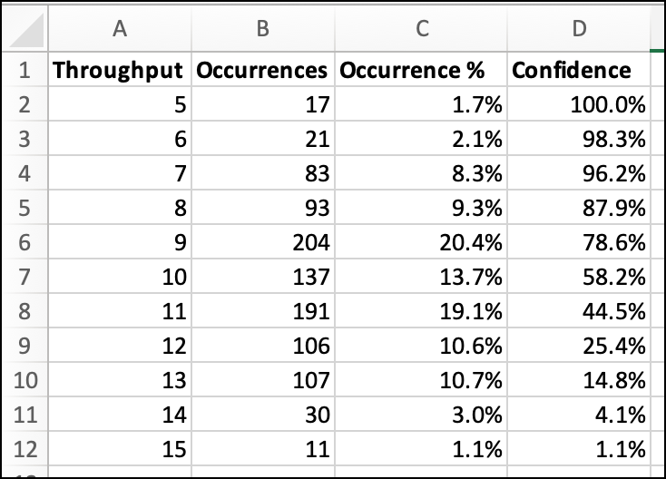

Slide 117
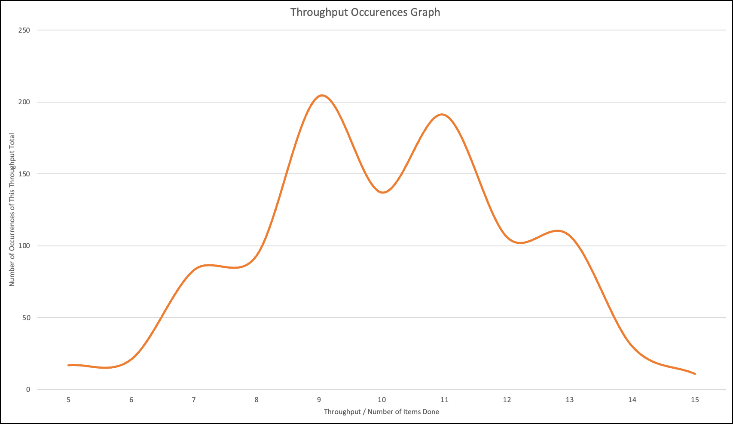

Slide 118
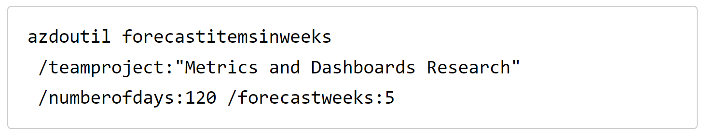
Forecast items in 5 weeks

Slide 119
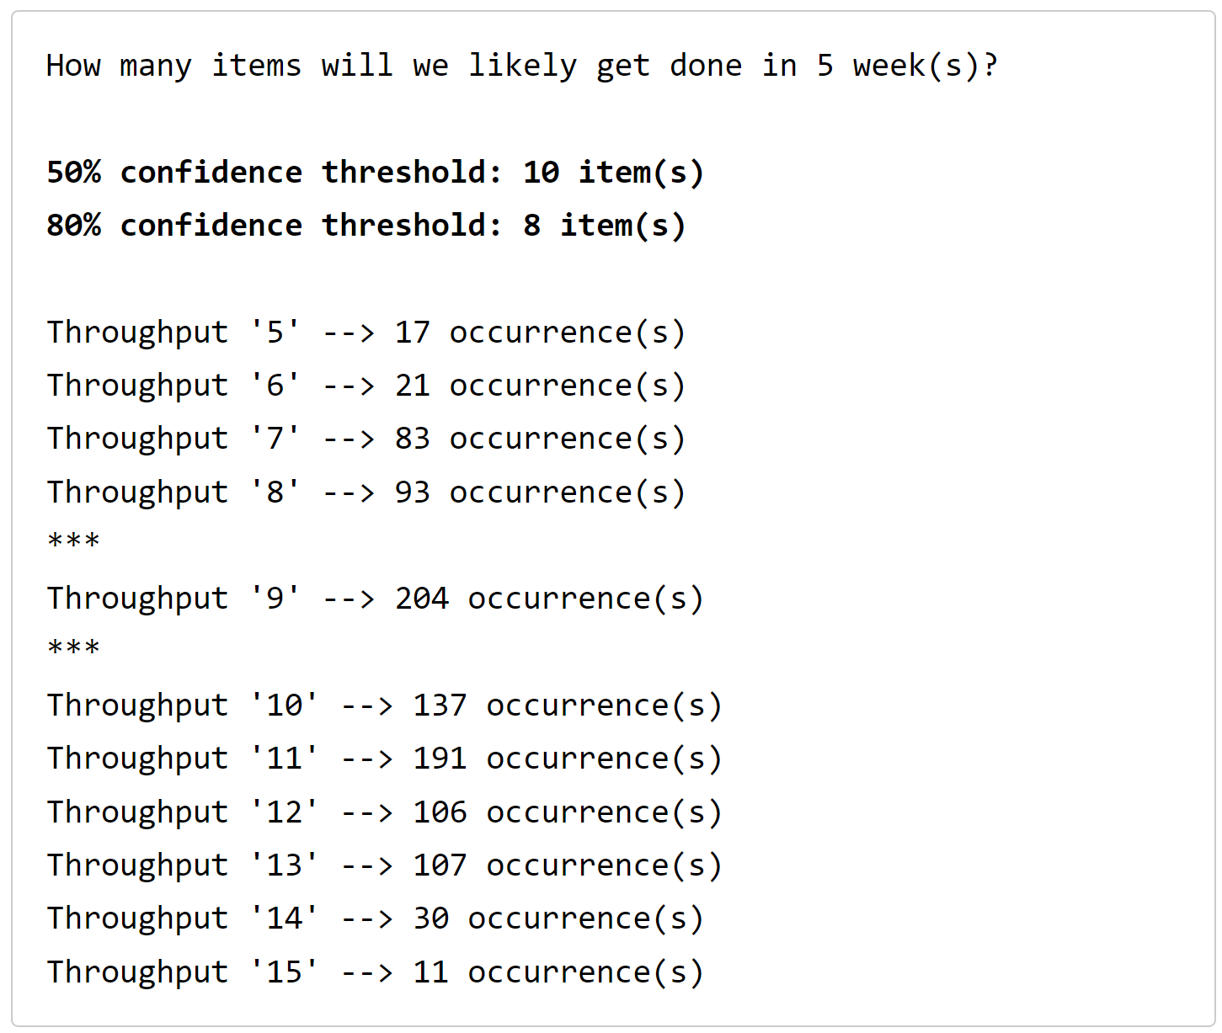
Forecast items in 5 weeks

Slide 120
Step 7:
I use Scrum.
Now where’s my stuff?
Predicting the future for fun and profit.

Slide 121
“Where’s my stuff?”

Slide 122
1) When will I get Product Backlog Item X?

Slide 123
2) How much done stuff will I have by Y date?

Slide 124
Product Backlog
Forecasting
Name | Size
Update payment system to convert USD to Bitcoin | 8
Fix layout and click problems on Safari on iPhone 6 | 3
Update payment system to support ApplePay | 5
Request PDF receipt delivered by email for past purchase | 2
Generate report to see orders by payment type | 3
Update payment system to take PayPal payments | 5
Mark transaction for fraud audit | 8
Upgrade site layout to support Internet Explorer 11 | 8
Refund in-store mobile purchase from administrator device | 5
Fix bugs related to jQuery upgrade (Defect #123, #456, #321, etc.) | 3
Fix bugs related to declined transactions using debit cards (Defect #132, #821) | 3
Book pre-paid appointment | 2
Request PDF summary of all purchases for date range | 3
Redeem gift card for in-store purchase | 2
Redeem gift card for mobile purchase | 3
Update public-facing website to use new logo and color scheme | 5
Update paid-user website to use new logo and color scheme | 3
Update Android app to use new logo and color scheme | 2
Update iOS app to use new logo and color scheme | 1
Real-time in-store purchase notification for managers on mobile admin app | 5
Request printed receipt after in-store mobile purchase | 5
Feature XYZ | 13
Feature ABC | 13
Use mobile camera to scan UPC and do a price comparison | 21
Create a lasting world peace | 21
Feature QWERTY | 21
Reporting dashboard for iOS & Android | 40
Federated Identity using external authentication providers | 40
Add membership card to Apple Wallet | 13
Use mobile camera to scan UPC for product and add to cart for in-store purchase | 8
Complete in-store mobile purchase | 8
Teach cats to do tax preparation | 80
RFID-based inventory control system | 80
Migrate application hosting to external cloud provider | 40
Talking unicorns | 120
Sprint 1
Sprint 2
Question:
When does “Update Android app to use new logo and color scheme” get done?
Sprint 3
Average Velocity = 21
→ Group PBIs into groups that total to 21
Sprint 4
Sprint Length = 2 weeks
PBI probably gets done in Sprint 4
4 sprints * 2 weeks
The Forecast for that PBI:
It’s done at the end of 8 weeks
? Sprint 5 ?
? Sprint 6 ?
? Sprint 7 ?
? Sprint 8 ?
? Sprint 9+ ?

Slide 125
Product Backlog
Forecasting
Name | Size
Update payment system to convert USD to Bitcoin | 8
Fix layout and click problems on Safari on iPhone 6 | 3
Update payment system to support ApplePay | 5
Request PDF receipt delivered by email for past purchase | 2
Generate report to see orders by payment type | 3
Update payment system to take PayPal payments | 5
Mark transaction for fraud audit | 8
Upgrade site layout to support Internet Explorer 11 | 8
Refund in-store mobile purchase from administrator device | 5
Fix bugs related to jQuery upgrade (Defect #123, #456, #321, etc.) | 3
Fix bugs related to declined transactions using debit cards (Defect #132, #821) | 3
Book pre-paid appointment | 2
Request PDF summary of all purchases for date range | 3
Redeem gift card for in-store purchase | 2
Redeem gift card for mobile purchase | 3
Update public-facing website to use new logo and color scheme | 5
Update paid-user website to use new logo and color scheme | 3
Update Android app to use new logo and color scheme | 2
Update iOS app to use new logo and color scheme | 1
Real-time in-store purchase notification for managers on mobile admin app | 5
Request printed receipt after in-store mobile purchase | 5
Feature XYZ | 13
Feature ABC | 13
Use mobile camera to scan UPC and do a price comparison | 21
Create a lasting world peace | 21
Feature QWERTY | 21
Reporting dashboard for iOS & Android | 40
Federated Identity using external authentication providers | 40
Add membership card to Apple Wallet | 13
Use mobile camera to scan UPC for product and add to cart for in-store purchase | 8
Complete in-store mobile purchase | 8
Teach cats to do tax preparation | 80
RFID-based inventory control system | 80
Migrate application hosting to external cloud provider | 40
Talking unicorns | 120
Sprint 1
Sprint 2
Question:
What can we ship at the end of
60 days?
Sprint 3
Average Velocity = 21
Sprint Length = 3 weeks (21 days)
60 days = ~ 2.85 sprints
That’s somewhere inside of Sprint 3
(Hint: There isn’t a perfect answer.)
The 60 Day Forecast:
Sprint 1 & Sprint 2 is highly likely.
Probably some of Sprint 3, too.
Sprint 4
? Sprint 5 ?
? Sprint 6 ?
? Sprint 7 ?
? Sprint 8 ?
? Sprint 9+ ?

Slide 126
Reminder:
Both of these ‘tricks’ require
1) a known velocity and
2) a ready product backlog.

Slide 127
New “high priority” items

Slide 128
“I’VE GOTTA HAVE THIS!!!!”
“I NEED THIS BUG FIXED!!!”
“I WANT THAT BUTTON TO BE ORANGE!!!”
Say yes
Open your backlog
”Here’s our current priority.”
“What do you think we should bump?”
Enlist them in solving the problem
Don’t assume it’s your problem alone to solve
New,
high-priority requirement?

Slide 129
Summary

Slide 130
Consider killing the project
Stop making promises about dates
Define what Done means
Figure out what the top priority items are for the next 2 to 4 sprints
Minimize Work In Progress (WIP)
Start using Sprint Goals
Focus on delivering to Done
  Verify you have the right people on the team
  Hold the team accountable as a unit
Backlog refinement
Consider Scrum, Kanban, and/or Flow Metrics
Automated builds, tests, and releases
TO DO

Slide 131
Any last questions?

Slide 132
Thank you.
www.benday.com | benday@benday.com

Slide 133
Sprint Goals
Tell stories with your Sprints

Slide 134
Humans like to tell stories.

Slide 135
Stories are part of our cultures.

Slide 136
It’s part of how we think.

Slide 137
It’s part of how we pass on knowledge.

Slide 138
It’s part of how we organize ourselves to get things done.

Slide 139
Stories help us to describe goals.

Slide 140
Without a clear goal, stuff gets fuzzy.

Slide 141
In Scrum, we can use story telling to our advantage.

Slide 142
Our goal at the end of every Sprint is to deliver done, working software.

Slide 143
That’s vague.
Our goal is to make software?

Slide 144
That doesn’t have m

Slide 145
During Sprint Planning, the team chooses some combination of PBIs in order to turn those PBIs into done, working software.

Slide 146
On a lot of teams, the idea is
“pick a bunch of PBIs then go work on them.”

Slide 147
There’s not much of a coherent theme or story to
“pick a bunch of PBIs then go work on them.”

Slide 148
No story ➔ tough to get focused.

Slide 149
No story ➔ Sprint PBIs are just a list

Slide 150
Without a story, as Scrum Master, you’ll be stuck “herding cats”.

Slide 151
If those PBIs make sense together, it’s easier to motivate people.

Slide 152
If those PBIs make sense together, it’s easier to motivate people for people to be self-motivated.

Slide 153
With a clear goal, people pull together.

Slide 154
With a clear goal, people easily understand the mission.

Slide 155
Not clear?

Slide 156
Let’s use Star Wars
Episode IV as an example.

Slide 157
It’s the first Star Wars movie and a bunch of stuff happens.

Slide 158
Let’s describe it as a list of stuff that has to be done.

Slide 159
Star Wars: The ‘To Do’ List
“What’s this movie about?”
“That sounds boring.”
A ‘to do’ list is an uninspiring goal.
Buy some used droids
Oil bath for C3PO
Pick up a package from Ben Kenobi
Sell the speeder
Get a drink at the bar at Mos Eisley
Fix the hyper-drive
Take an X-wing out for a spin
Get a medal & take a goofy picture

Slide 160
Here’s a better goal…

Slide 161
“Rescue the Princess & blow up the Death Star.”

Slide 162
“Rescue the Princess & blow up the Death Star.”
Easily understood
Leaves it to the team to figure it how
New information? → Adjust & try a new way
Just get it done
Self-organize
Motivation is clear
Much stronger sense of accomplishment than
“I got my ‘to do’ list done.”

Slide 163
The sense of accomplishment helps motivate the team for next time.

Slide 164
Sprint Goal.

Slide 165
A Sprint Goal is a short statement of purpose for the Sprint.

Slide 166
Sprint Backlog: No Goal
Product Backlog Item (PBI)
Update payment system to convert USD to Bitcoin
Fix layout and click problems on Safari on iPhone 6
Upgrade site layout to support Internet Explorer 11
Update payment system to support ApplePay
Update payment system to take PayPal payments
Generate report to see orders by payment type
Request PDF receipt delivered by email for past purchase
Mark transaction for fraud audit
Implied Goal:
“Get those all done”

Slide 167
Sprint Backlog: Clear Goal
Product Backlog Item (PBI)
Update payment system to convert USD to Bitcoin
Fix layout and click problems on Safari on iPhone 6
Upgrade site layout to support Internet Explorer 11
Update payment system to support ApplePay
Update payment system to take PayPal payments
Generate report to see orders by payment type
Request PDF receipt delivered by email for past purchase
Mark transaction for fraud audit
Goal:
Add new payment types to
payment system & fix
lingering layout issues.

Slide 168
Sprint Backlog: Clear Goal → “Do these fit?”
Product Backlog Item (PBI)
Update payment system to convert USD to Bitcoin
Fix layout and click problems on Safari on iPhone 6
Upgrade site layout to support Internet Explorer 11
Update payment system to support ApplePay
Update payment system to take PayPal payments
Generate report to see orders by payment type
Request PDF receipt delivered by email for past purchase
Mark transaction for fraud audit
Goal:
Add new payment types to
payment system & fix
lingering layout issues.

Slide 169
Help your team to organize.
Create a Sprint Goal.

